Slide 1

Deep Learning

Slide 2

On completion of this course, you will be able to:
Describe the definition and development of neural networks.
Learn about the important components of deep learning neural networks.
Understand training and optimization of neural networks.
Describe common problems in deep learning.

Slide 3
Deep Learning Summary
Training Rules
Activation Function
Normalizer
Optimizer
Types of Neural Networks
Common Problems

Slide 4
Traditional Machine Learning and Deep Learning
As a model based on unsupervised feature learning and feature hierarchy learning, deep learning has great advantages in fields such as computer vision, speech recognition, and natural language processing.
Traditional Machine Learning | Deep Learning
Low hardware requirements on the computer: Given the limited computing amount, the computer does not need a GPU for parallel computing generally. | Higher hardware requirements on the computer: To execute matrix operations on massive data, the computer needs a GPU to perform parallel computing.
Applicable to training under a small data amount and whose performance cannot be improved continuously as the data amount increases. | The performance can be high when high-dimensional weight parameters and massive training data are provided.
Level-by-level problem breakdown | E2E learning
Manual feature selection | Algorithm-based automatic feature extraction
Easy-to-explain features | Hard-to-explain features
Notes:
As a model based on unsupervised feature learning and feature hierarchy learning, deep learning has great advantages in fields such as computer vision, speech recognition, and natural language processing.
The two kinds of learning are compared from five aspects.

Slide 5
Traditional Machine Learning
Issue analysis
Problem locating
Data cleansing
Feature extraction
Feature selection
Model training
Question: Can we use an algorithm to automatically execute the procedure?
Execute inference, prediction, and identification
Notes:
Issue analysis and task determining
Data cleansing
Signature extraction
Feature selection
Model training
Inference, prediction, and identification
Generally, features in machine learning are selected manually. More features indicate more information and higher identification accuracy.
However, more features indicate higher calculation complexity and larger search space. Training data appears to be sparse in the overall feature vectors, affecting similarity determination, that is, dimension exploration.
In addition, features that have nothing to do with classification may interfere with the learning effect.
Conclusion: More features do not mean better learning effect. Proper feature selection is the key to identification success. The number of required features can be determined by the learning problem.

Slide 6
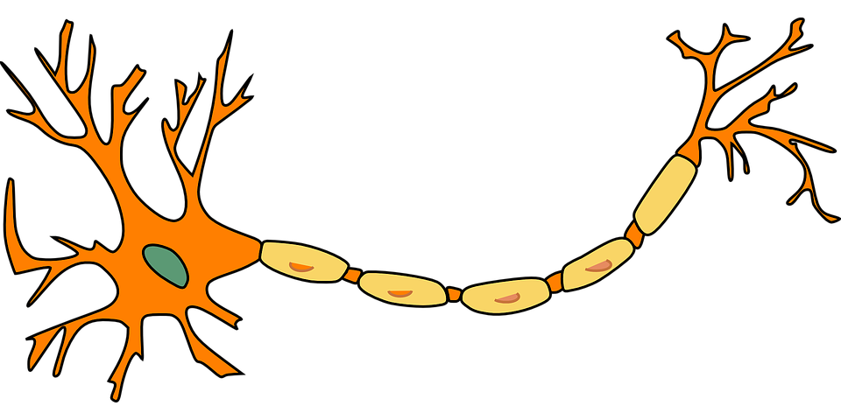
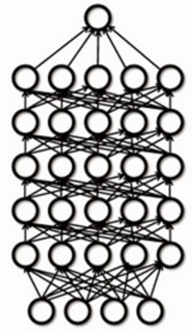
Deep Learning
Generally, the deep learning architecture is a deep neural network. "Deep" in "deep learning" refers to the number of layers of the neural network.
Dendrite
Synapse
Output layer
Nucleus
Hidden layer
Axon
Output layer
Input layer
Input layer
Hidden layer
Human neural network
Perceptron
Deep neural network
Notes:
What is deep learning?
Generally, the deep learning architecture is a deep neural network. "Deep" in "deep learning" refers to the number of layers of the neural network.
The network is built by simulating the human neural network.
In the design and application of artificial neural networks, the following factors need to be considered: neuron functions, connection modes among neurons, and network learning (training).

Slide 7
Artificial Neural Network (ANN)
Currently, the definition of the neural network has not been determined yet. Hecht Nielsen, a neural network researcher in the U.S., defines a neural network as a computer system composed of simple and highly interconnected processing elements, which process information by dynamic response to external inputs.
A neural network can be simply expressed as an information processing system designed to imitate the human brain structure and functions based on its source, features, and explanations.
Artificial neural network (neural network): Formed by artificial neurons connected to each other, the neural network extracts and simplifies the human brain's microstructure and functions. It is an important approach to simulate human intelligence and reflect several basic features of human brain functions, such as concurrent information processing, learning, association, model classification, and memory.
Notes:
Let's see what a neural network is.

Slide 8
Development History of Neural Networks
SVM
Deep network
Perceptron
XOR
MLP
Golden age
AI winter
1958
1970
1986
1995
2006
Notes:
Development history of neural networks (milestones of deep learning):
Budding neural network (1958–1969)
In 1958, Frank Rosenblatt invented the perceptron algorithm.
In 1969, Marvin Minsky, pioneer of artificial intelligence in the US, questioned that the perceptron could handle only linear classification problems and failed to classify even the simplest XOR problems. The research on the perceptron was doomed to failure.
Developing neural network (1986–1998)
The second-generation neural network: In 1986, G. E. Hinton, a deep learning expert, developed a BP algorithm suitable for multilayer perceptron (MLP) and used Sigmoid for non-linear mapping, which solved the problem of non-linear classification and learning.
Universal approximation theorem: In 1989, Robert Hecht-Nielsen proved that a continuous function f in any closed interval could be approximated by a BP network containing a hidden layer.
Emerging neural network (since 2006)
Year 2006 is the first year of deep learning. In 2006, Hinton proposed a solution to the vanishing gradient problem in the deep neural network training: weight initialization for unsupervised pre-training+weight adjustment for supervised training.
In 2012, CNN neural network of Hinton's team overwhelmed other methods and won the first prize in the top image recognition competition ImageNet, setting off an upsurge of deep learning.
In 2016, the deep learning AI program AlphaGo developed by Google beat the Go world champion Lee Sedol who is a player of 9 dan rank, further promoting the popularity of deep learning.

Slide 9
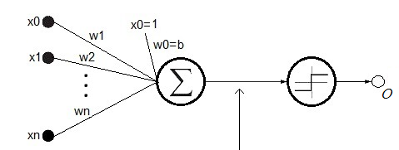
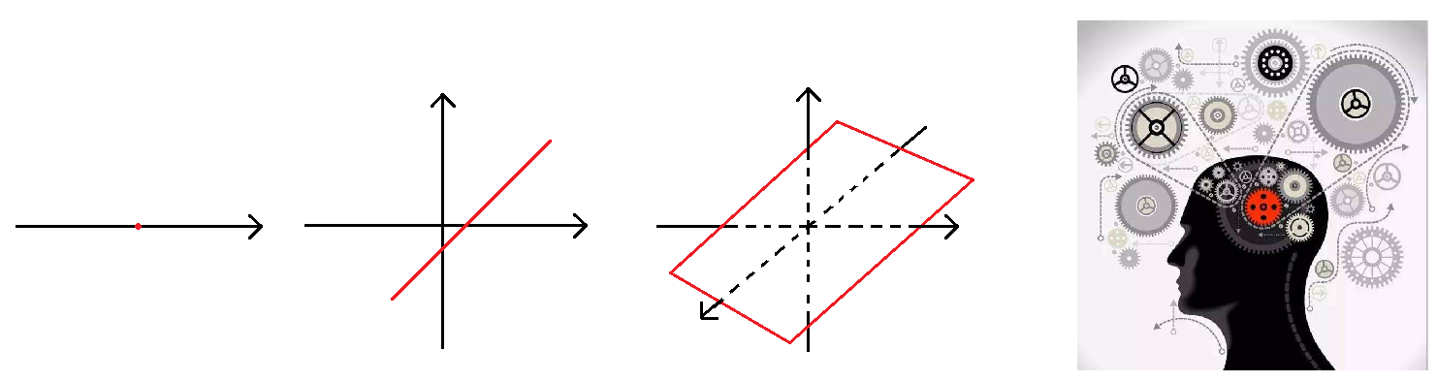
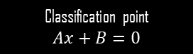
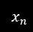
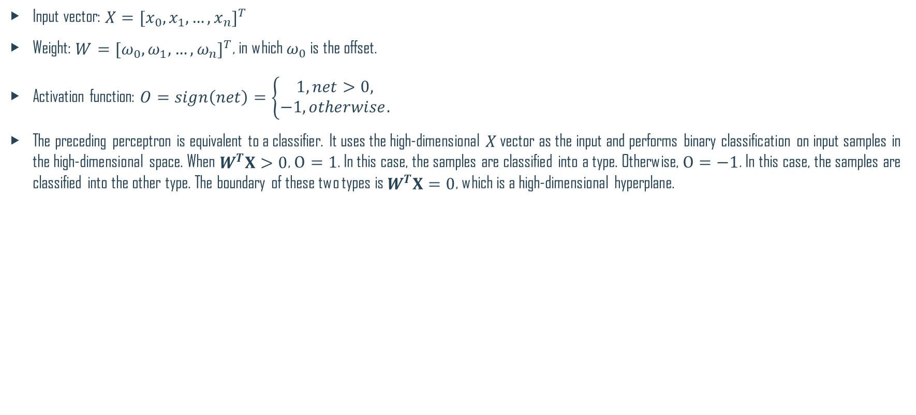
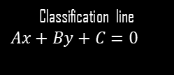
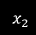
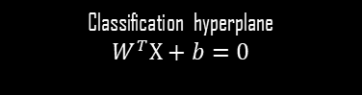
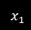
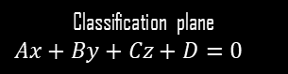
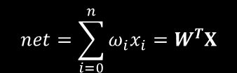
Single-Layer Perceptron
Input vector: $X={[x_{0},x_{1},…,x_{n}]}^{T}$
Weight: $W={[ω_{0},ω_{1},…,ω_{n}]}^{T}$, in which $ω_{0}$ is the offset.
Activation function: $O=sign\left(net\right)=\left\{\begin{aligned}1,net>0, \\ −1,otherwise.\end{aligned}\right.$
The preceding perceptron is equivalent to a classifier. It uses the high-dimensional $X$ vector as the input and performs binary classification on input samples in the high-dimensional space. When $W^{T}X>0$, $O=1$. In this case, the samples are classified into a type. Otherwise, $O=−1$. In this case, the samples are classified into the other type. The boundary of these two types is $W^{T}X=0$, which is a high-dimensional hyperplane.
$$x_{1}$$
$$x_{2}$$
$$x_{n}$$
$$net=\sum_{i=0}^{n}{ω_{i}x_{i}}=W^{T}X$$
Classification point
$$Ax+B=0$$
Classification line
$$Ax+By+C=0$$
Classification plane
$$Ax+By+Cz+D=0$$
Classification hyperplane
$$W^{T}X+b=0$$
Notes:
First, let's take a look at the simplest neural network — single-layer perceptron.
In 1958, Frank Rosenblatt invented the perceptron algorithm. Such an algorithm coexisted with machine learning for more than a decade.
In 1969, Marvin Minsky, pioneer of artificial intelligence in the US, questioned that the perceptron could handle only linear classification problems and failed to classify even the simplest XOR problems. The research on the perceptron was doomed to failure.

Slide 10
XOR Problem
In 1969, Minsky, an American mathematician and AI pioneer, proved that a perceptron is essentially a linear model that can only deal with linear classification problems, but cannot process non-linear data.
AND
OR
XOR
Notes:
Restriction of the single-layer perceptron: XOR problem
Reference: https://blog.csdn.net/qq_18515405/article/details/42123697
Under this context, the multilayer perceptron was invented.

Slide 11
Feedforward Neural Network
Input layer
Output layer
Hidden layer 1
Hidden layer 2
Notes:
The multilayer perceptron is a feedforward neural network.
It is the simplest neural network with neurons arranged in layers. It is more widely used and develops faster than other artificial neural networks.
Input nodes do not have the calculation capability and are only used to represent element values of the input vector.
The neuron having the computing capability at each layer is referred to as the computing unit. Each neuron is connected only to the neurons of the previous layer.
A unidirectional multi-layer structure is used to receive the output of the previous layer and send the output to the next layer. Each layer includes several neurons, and the neurons at the same layer are not connected to each other. Only unidirectional inter-layer information transmission is supported.

Slide 12
Solution of XOR
w0
w1
w2
w3
w4
XOR
XOR
w5

Slide 13
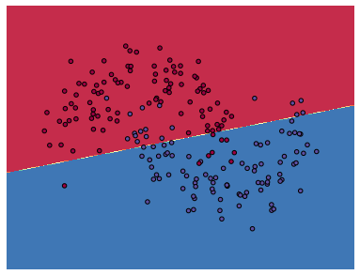
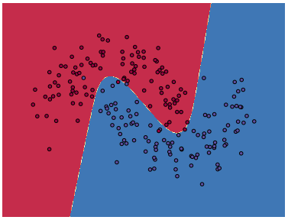
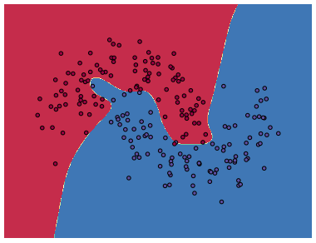
Impacts of Hidden Layers on A Neural Network
0 hidden layers
3 hidden layers
20 hidden layers
Notes:
More hidden layers indicate the stronger identification capability of the neural network.

Slide 14
Deep Learning Summary
Training Rules
Activation Function
Normalizer
Optimizer
Types of Neural Networks
Common Problems

Slide 15
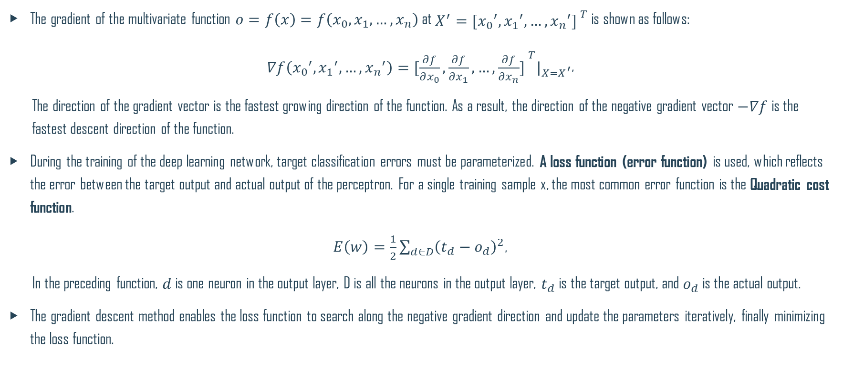
Gradient Descent and Loss Function
The gradient of the multivariate function $o=f\left(x\right)=f\left(x_{0},x_{1},…,x_{n}\right)$ at $X^{′}={[{x_{0}}^{′},{x_{1}}^{′},…,{x_{n}}^{′}] }^{T}$ is shown as follows:
$∇f\left({x_{0}}^{′},{x_{1}}^{′},…,{x_{n}}^{′}\right)={[\frac{∂f}{∂x_{0}},\frac{∂f}{∂x_{1}},…,\frac{∂f}{∂x_{n}}] }^{T}|_{X=X^{′}}$,
The direction of the gradient vector is the fastest growing direction of the function. As a result, the direction of the negative gradient vector $−∇f$ is the fastest descent direction of the function.
During the training of the deep learning network, target classification errors must be parameterized. A loss function (error function) is used, which reflects the error between the target output and actual output of the perceptron. For a single training sample x, the most common error function is the Quadratic cost function.
$E\left(w\right)=\frac{1}{2}\sum_{d∈D}{{\left(t_{d}−o_{d}\right)}^{2}}$,
In the preceding function, $d$ is one neuron in the output layer, D is all the neurons in the output layer, $t_{d}$ is the target output, and $o_{d}$ is the actual output.
The gradient descent method enables the loss function to search along the negative gradient direction and update the parameters iteratively, finally minimizing the loss function.
Notes:
This loss function has the following features:
Uses the weight vector as the independent variable.
Uses the sum of squares of the difference between the target output t_d and actual output o_d of each training sample as the main body.
There is a coefficient 1/2.
Once the training sample is given, the input and target output are constants. The actual output varies with $W$. The independent variable of the error function is $W$.
Usage of the coefficient 1/2 which is difficult to understand is as follows: When you take a derivative of $E$ with respect to the independent variable, the coefficient 1/2 is multiplied by the index 2 and the number 1 is obtained. The specific calculation will be described in the following text.

Slide 16
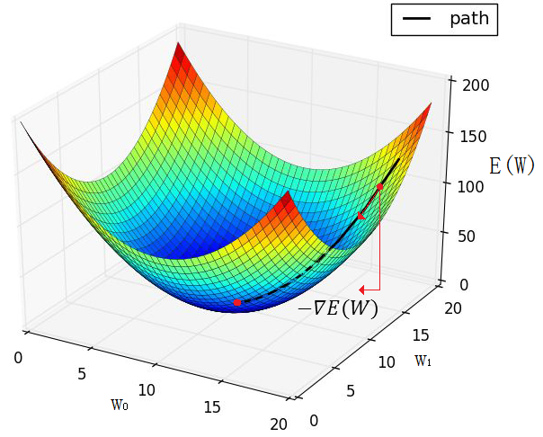
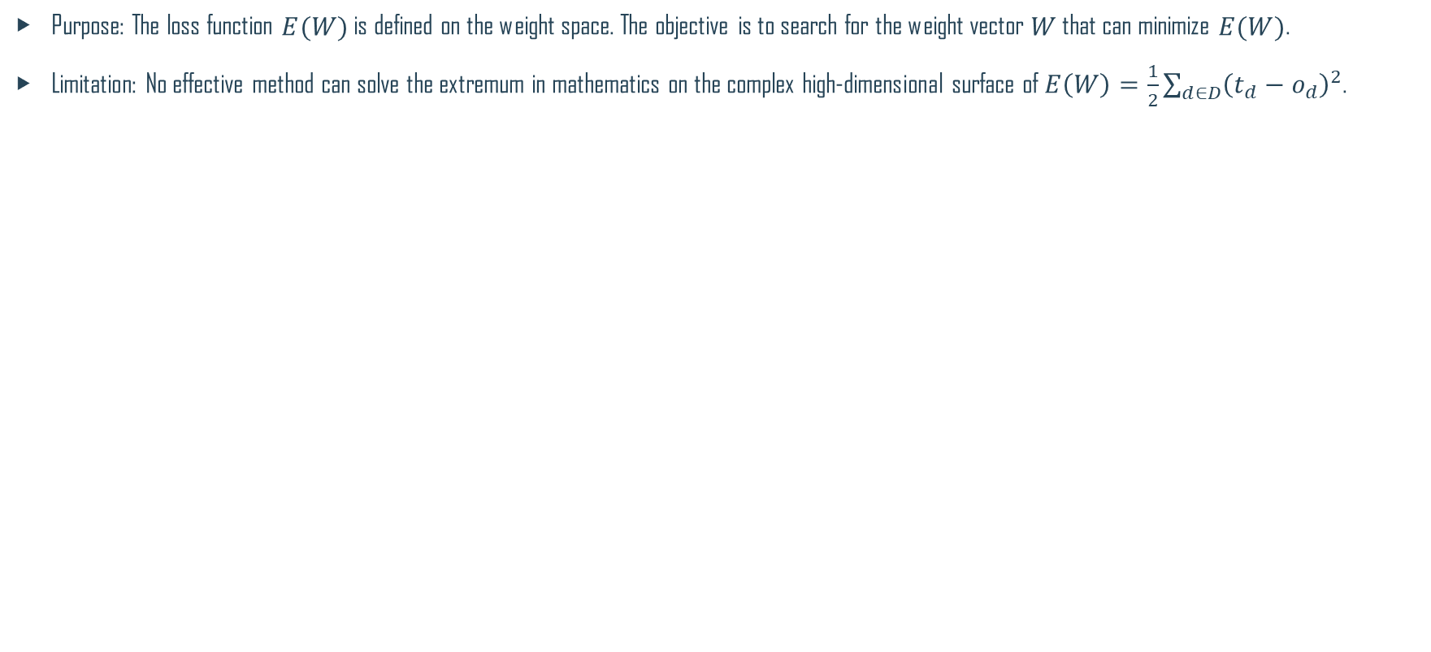
Extrema of the Loss Function
Purpose: The loss function $E(W)$ is defined on the weight space. The objective is to search for the weight vector $W$ that can minimize $E(W)$.
Limitation: No effective method can solve the extremum in mathematics on the complex high-dimensional surface of $E\left(W\right)=\frac{1}{2}\sum_{d∈D}{{\left(t_{d}−o_{d}\right)}^{2}}$.
Example of gradient descent of binary paraboloid
Notes:
Approach: The core approach of the gradient descent method is as follows: The negative gradient direction is the fastest descent direction of the function. Therefore, the minimum point of $E(W)$ is expected to exist along the −() direction.

Slide 17
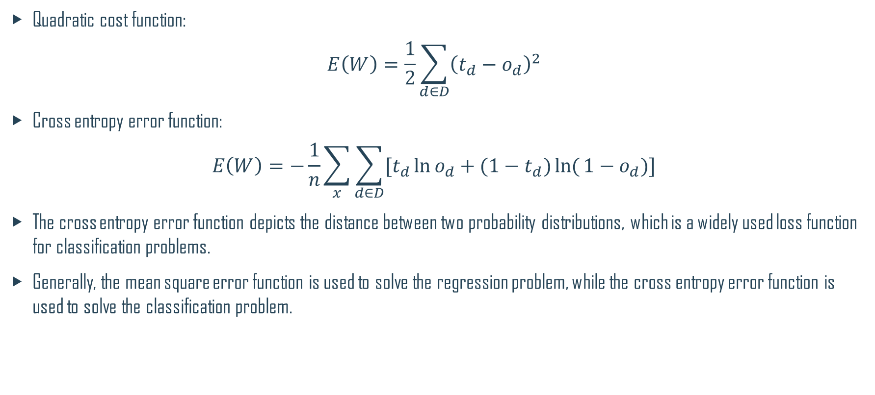
Common Loss Functions in Deep Learning
Quadratic cost function:
$$E\left(W\right)=\frac{1}{2}\sum_{d∈D}{{\left(t_{d}−o_{d}\right)}^{2}}$$
Cross entropy error function:
$$E\left(W\right)=−\frac{1}{n}\sum_{x}{\sum_{d∈D}{[t_{d}\ln{o_{d}}+(1−t_{d})\ln{(}{1−o}_{d})]}}$$
The cross entropy error function depicts the distance between two probability distributions, which is a widely used loss function for classification problems.
Generally, the mean square error function is used to solve the regression problem, while the cross entropy error function is used to solve the classification problem.

Slide 18
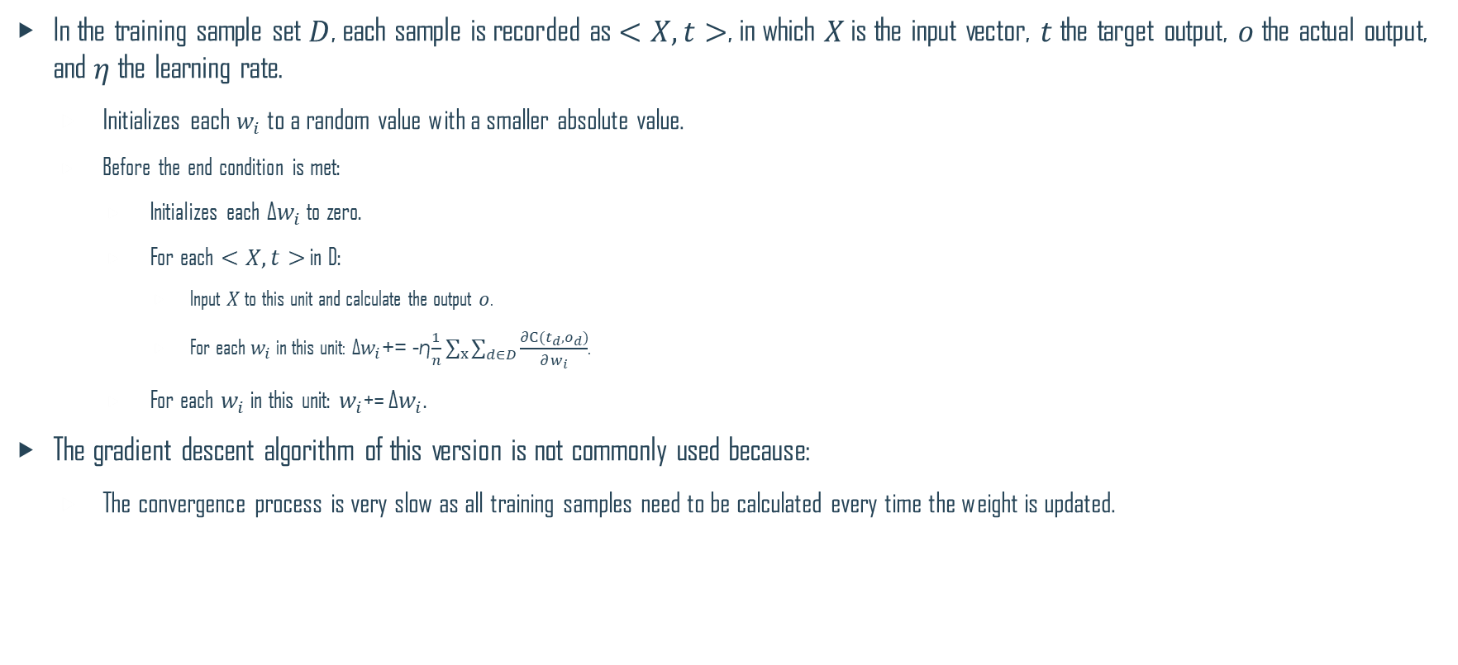
Batch Gradient Descent Algorithm (BGD)
In the training sample set $D$, each sample is recorded as $<X, t>$, in which $X$ is the input vector, $t$ the target output, $o$ the actual output, and $η$ the learning rate.
Initializes each $w_{i}$ to a random value with a smaller absolute value.
Before the end condition is met:
Initializes each ∆$w_{i}$ to zero.
For each $<X, t>$ in D:
Input $X$ to this unit and calculate the output $o$.
For each $w_{i}$ in this unit: ∆$w_{i}$+= -η$\frac{1}{n}\sum_{x}{\sum_{d∈D}{\frac{∂C(t_{d},o_{d})}{∂w_{i}}}}$.
For each $w_{i}$ in this unit: $w_{i}$+= ∆$w_{i}$.
The gradient descent algorithm of this version is not commonly used because:
The convergence process is very slow as all training samples need to be calculated every time the weight is updated.

Slide 19
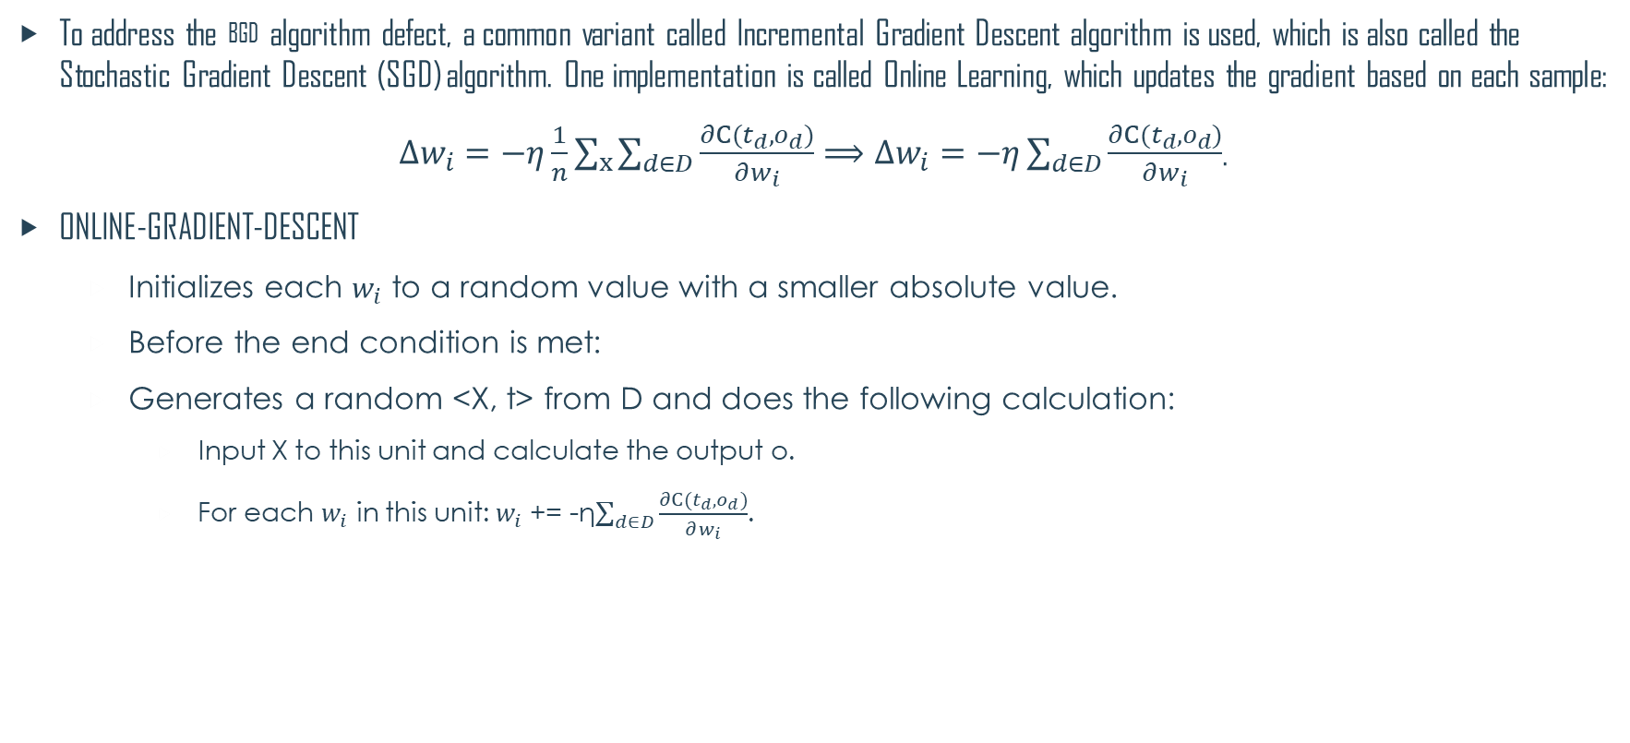
Stochastic Gradient Descent Algorithm (SGD)
To address the BGD algorithm defect, a common variant called Incremental Gradient Descent algorithm is used, which is also called the Stochastic Gradient Descent (SGD) algorithm. One implementation is called Online Learning, which updates the gradient based on each sample:
$∆w_{i}=−η\frac{1}{n}\sum_{x}{\sum_{d∈D}{\frac{∂C(t_{d},o_{d})}{∂w_{i}}}}⟹∆w_{i}=−η\sum_{d∈D}{\frac{∂C(t_{d},o_{d})}{∂w_{i}}}$.
ONLINE-GRADIENT-DESCENT
Initializes each $w_{i}$ to a random value with a smaller absolute value.
Before the end condition is met:
Generates a random <X, t> from D and does the following calculation:
Input X to this unit and calculate the output o.
For each $w_{i}$ in this unit: $w_{i}$+= -η$\sum_{d∈D}{\frac{∂C(t_{d},o_{d})}{∂w_{i}}}$.
Notes:
This gradient descent algorithm goes to another extreme, that is, updating the weight based on each sample. Most training samples contain noises. As a result, when the extrema is approximated to, the gradient direction is oriented up and down near the extrema but difficult to converge to the extrema.

Slide 20
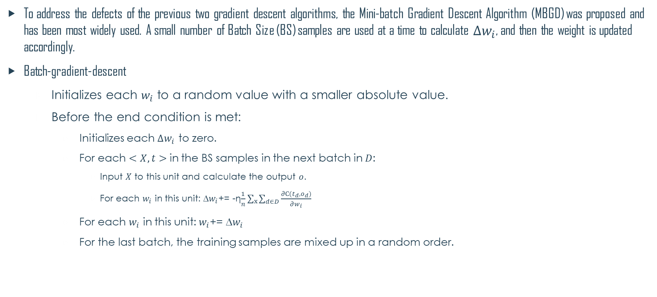
Mini-Batch Gradient Descent Algorithm (MBGD)
To address the defects of the previous two gradient descent algorithms, the Mini-batch Gradient Descent Algorithm (MBGD) was proposed and has been most widely used. A small number of Batch Size (BS) samples are used at a time to calculate $∆w_{i}$, and then the weight is updated accordingly.
Batch-gradient-descent
Initializes each $w_{i}$ to a random value with a smaller absolute value.
Before the end condition is met:
Initializes each $∆w_{i}$ to zero.
For each $<X, t>$ in the BS samples in the next batch in $D$:
Input $X$ to this unit and calculate the output $o$.
For each $w_{i}$ in this unit: ∆$w_{i}$+= -η$\frac{1}{n}\sum_{x}{\sum_{d∈D}{\frac{∂C(t_{d},o_{d})}{∂w_{i}}}}$
For each $w_{i}$ in this unit: $w_{i}$+= ∆$w_{i}$
For the last batch, the training samples are mixed up in a random order.
Notes:
This gradient descent algorithm considers both the efficiency and gradient stability. It is easy to overshoot the local minimum and is the most commonly used gradient descent algorithm in actual work. The value of BS varies with specific problems. Generally, the value is 128.

Slide 21
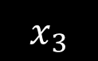
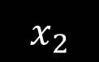
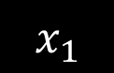
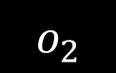
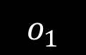
Backpropagation Algorithm (1)
Signals are propagated in forward direction, and errors are propagated in backward direction.
In the training sample set D, each sample is recorded as <X, t>, in which X is the input vector, t the target output, o the actual output, and w the weight coefficient.
Loss function:
Forward propagation direction
$$x_{1}$$
$$o_{1}$$
$$x_{2}$$
$$o_{2}$$
$$x_{3}$$
Output layer
Input layer
Hidden layer
Backpropagation direction

Slide 22
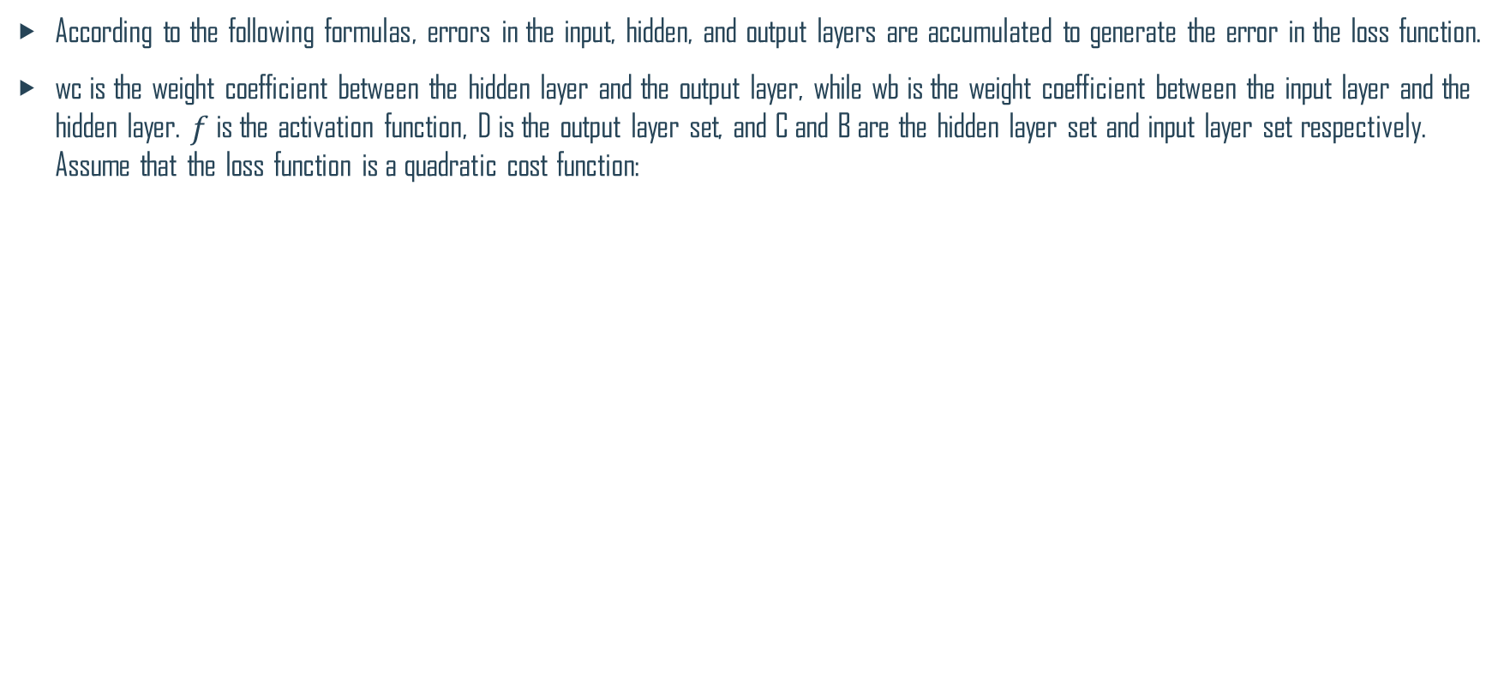
Backpropagation Algorithm (2)
According to the following formulas, errors in the input, hidden, and output layers are accumulated to generate the error in the loss function.
wc is the weight coefficient between the hidden layer and the output layer, while wb is the weight coefficient between the input layer and the hidden layer. $f$ is the activation function, D is the output layer set, and C and B are the hidden layer set and input layer set respectively. Assume that the loss function is a quadratic cost function:
Output layer error:
Expanded hidden layer error:
Expanded input layer error:

Slide 23
Backpropagation Algorithm (3)
To minimize error E, the gradient descent iterative calculation can be used to solve wc and wb, that is, calculating wc and wb to minimize error E.
Formula:
If there are multiple hidden layers, chain rules are used to take a derivative for each layer to obtain the optimized parameters by iteration.

Slide 24
Backpropagation Algorithm (4)
For a neural network with any number of layers, the arranged formula for training is as follows:
The BP algorithm is used to train the network as follows:
Takes out the next training sample <X, T>, inputs X to the network, and obtains the actual output o.
Calculates output layer δ according to the output layer error formula (1).
Calculates δ of each hidden layer from output to input by iteration according to the hidden layer error propagation formula (2).
According to the δ of each layer, the weight values of all the layer are updated.

Slide 25
Deep Learning Summary
Training Rules
Activation Function
Normalizer
Optimizer
Types of Neural Networks
Common Problems

Slide 26
Activation Function
Activation functions are important for the neural network model to learn and understand complex non-linear functions. They allow introduction of non-linear features to the network.
Without activation functions, output signals are only simple linear functions. The complexity of linear functions is limited, and the capability of learning complex function mappings from data is low.
Activation Function

Slide 27
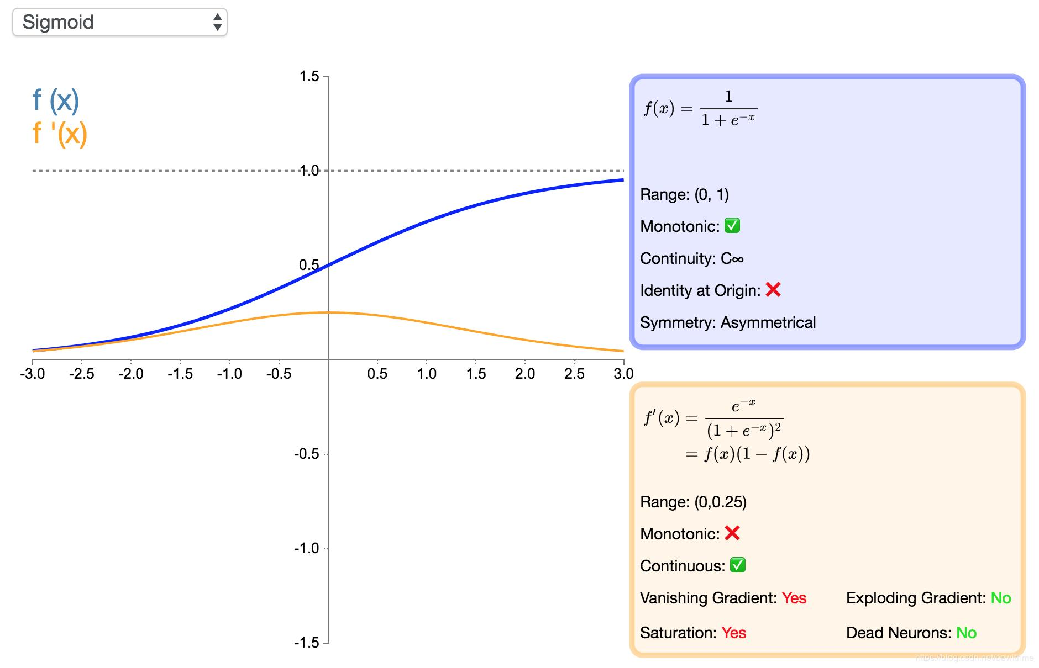
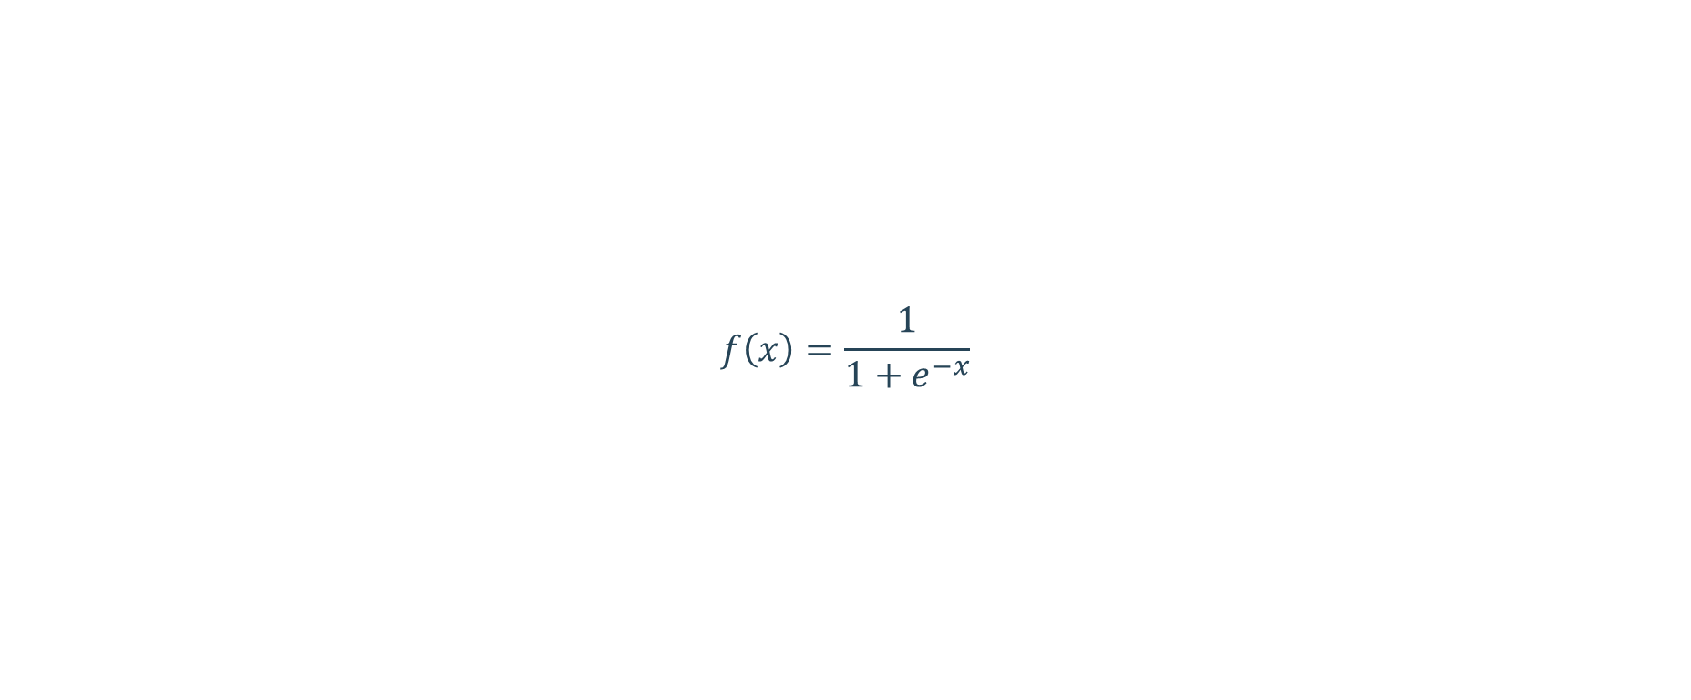
Sigmoid
$$f\left(x\right)=\frac{1}{1+e^{−x}}$$
Notes:
The sigmoid function is monotonic, continuous, and easy to derive. The output is bounded, and the network is easy to converge. However, we see that the derivative of the sigmoid function is close to 0 at the position away from the central point. When the network is very deep, more and more backpropagation gradients fall into the saturation area so that the gradient module becomes smaller. Generally, if the sigmoid network has five or fewer layers, the gradient is degraded to 0, which is difficult to train. This phenomenon is a vanishing gradient. In addition, the output of the sigmoid is not zero-centered.

Slide 28
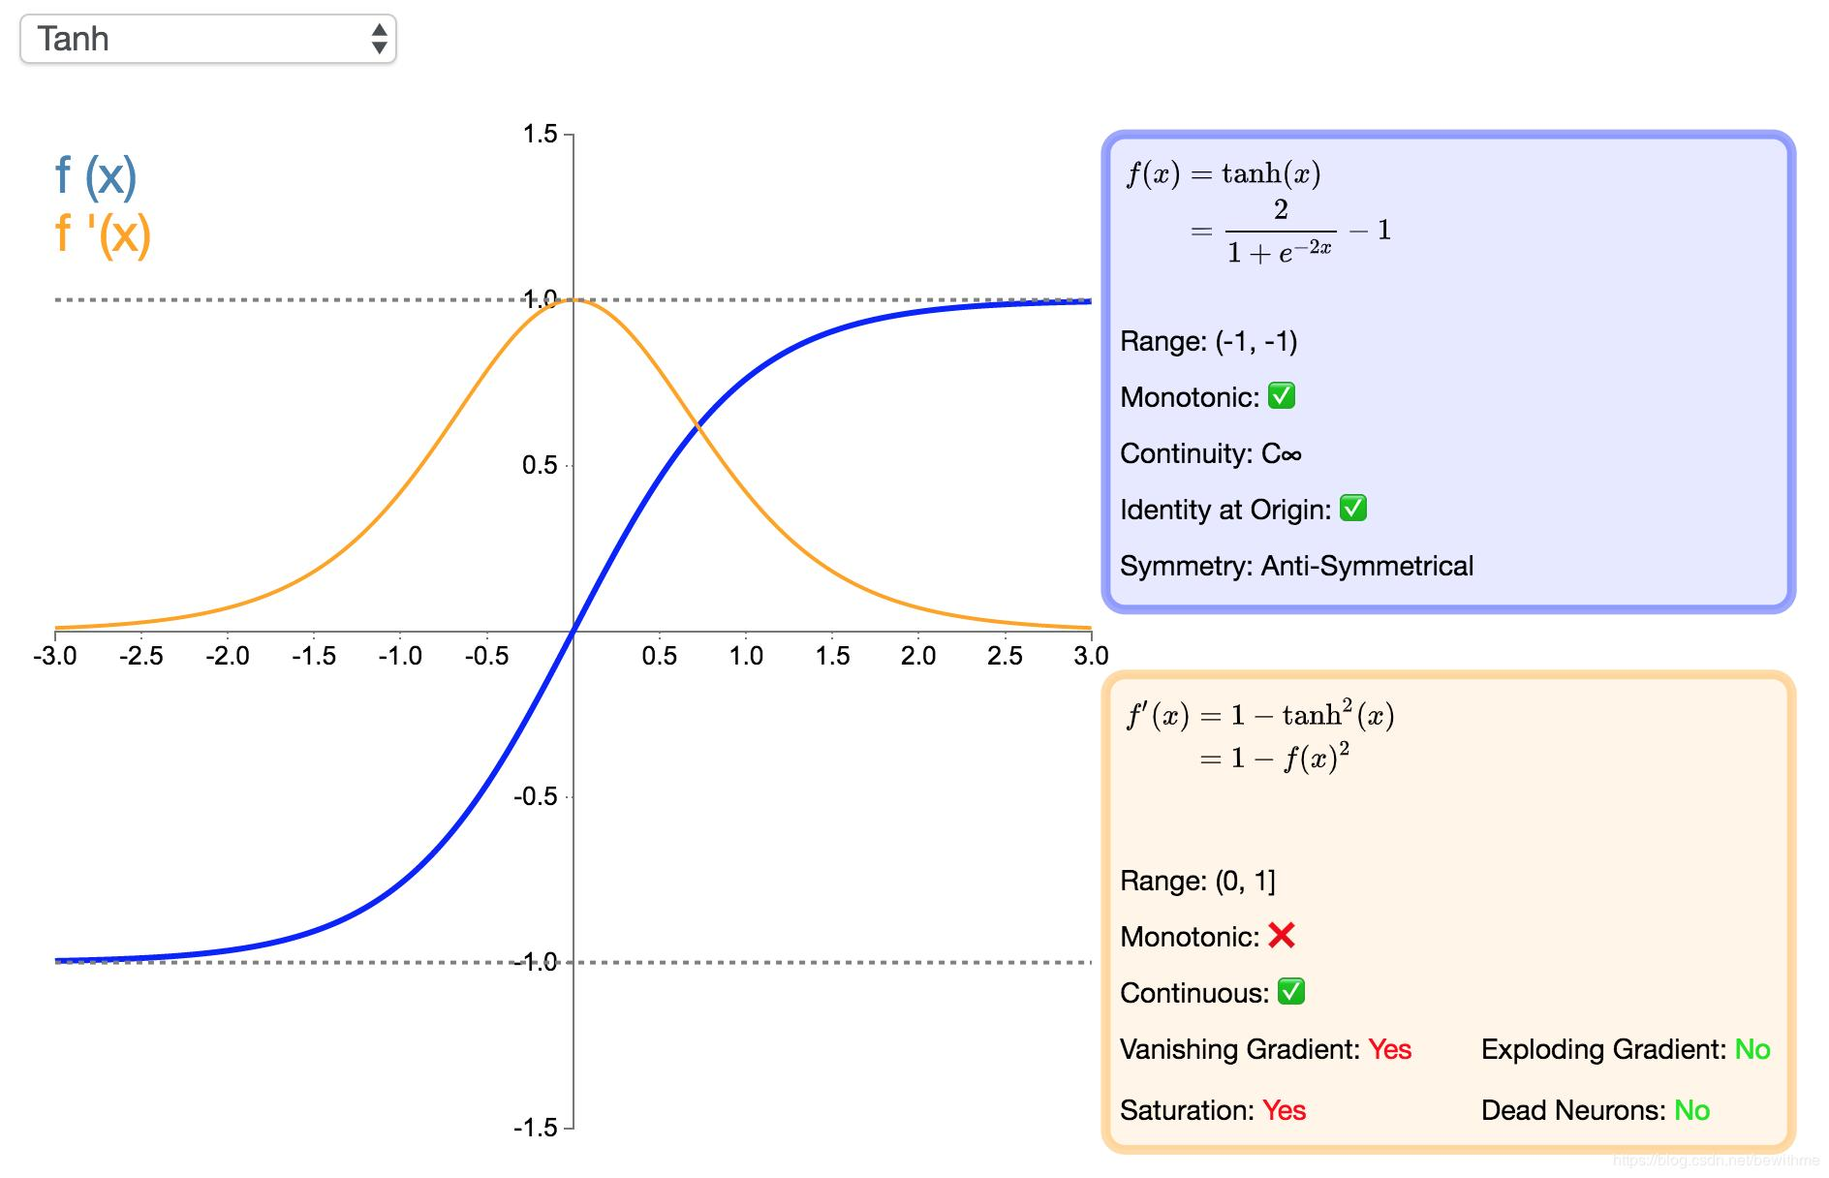
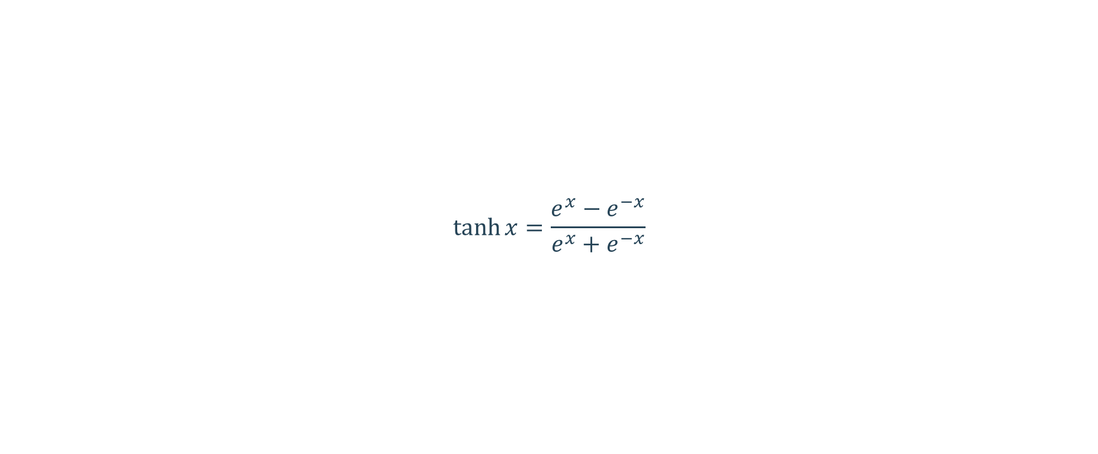
Tanh
$$\tanh{x}=\frac{e^{x}−e^{−x}}{e^{x}+e^{−x}}$$
Notes:
Tanh function and sigmoid function have similar shortcomings. The derivative of the tanh function is nearly 0 at its extremes. However, because the tanh function is symmetric with respect to the origin, the average of the outputs is closer to 0 than that of the sigmoid function. Therefore, SGD can reduce the required number of iterations because it is closer to the natural gradient descent.

Slide 29
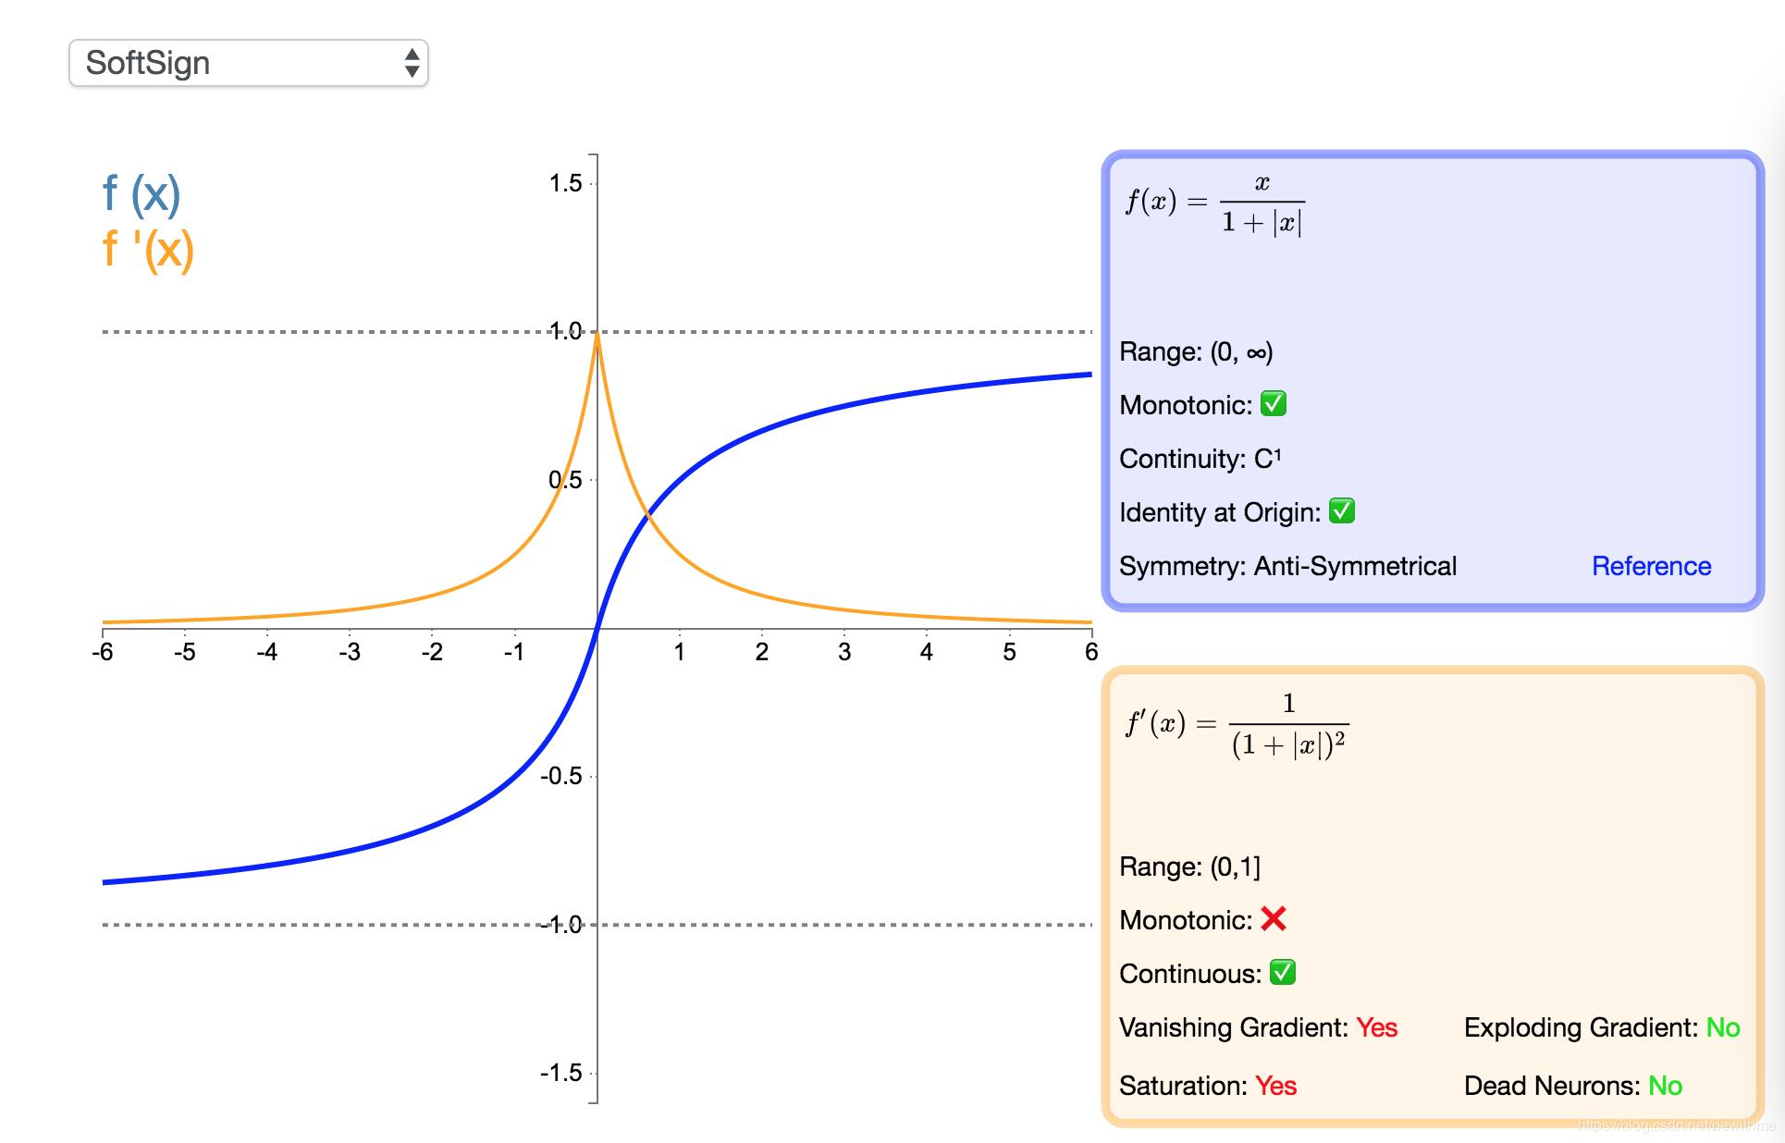
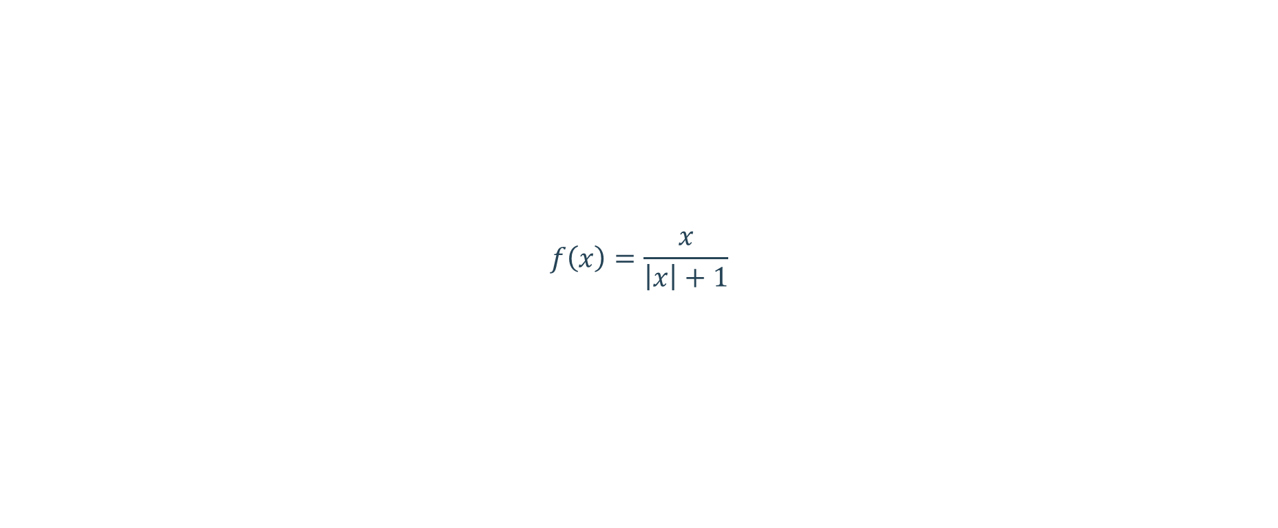
Softsign
$$f\left(x\right)=\frac{x}{\left|x\right|+1}$$
Notes:
This function saturates more slowly than the tanh function.
When the sigmoid, tanh, and softsign functions are used to train a deep neural network, the vanishing gradient problem is inevitable. The derivative of the functions approaches 0 at its extremes. When the network is very deep, more and more backpropagation gradients fall into the saturation area so that the gradient module becomes smaller and finally close to 0, and the weight cannot be updated.
Generally, if the neural network has more than five layers, the gradient is degraded to 0, which is difficult to train.

Slide 30
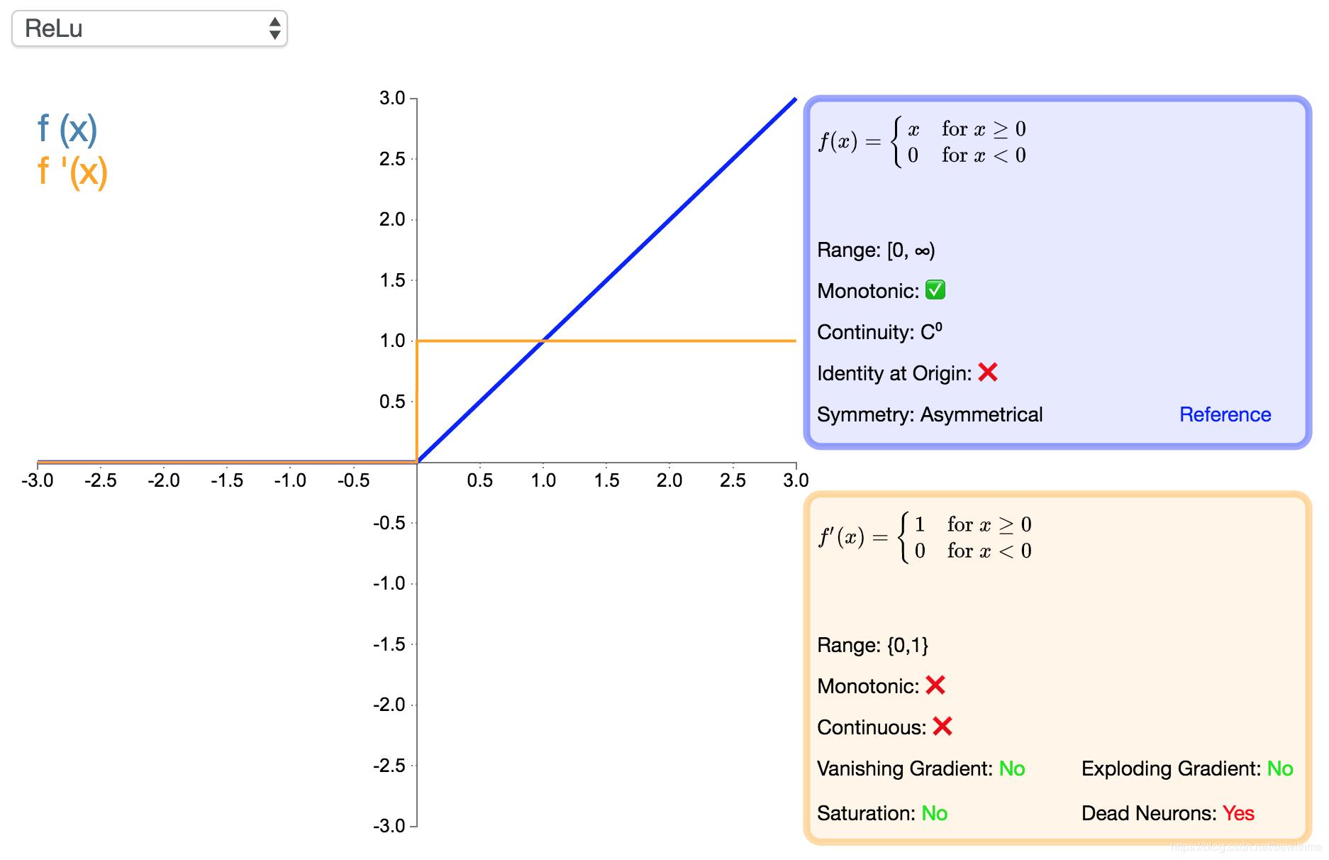
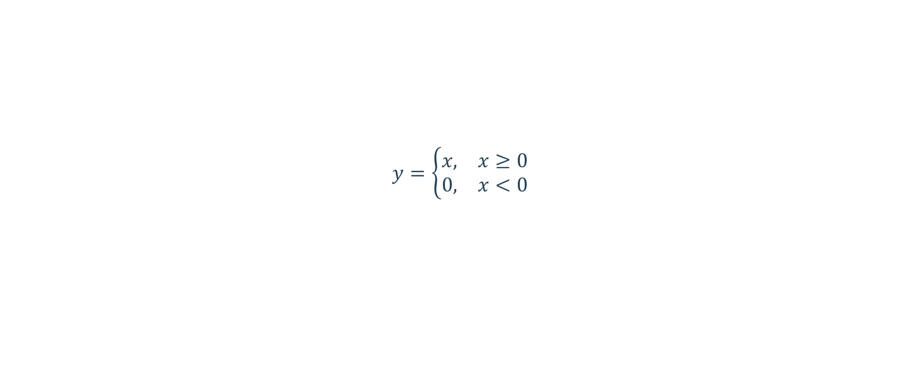
Rectified Linear Unit (ReLU)
$$y=\left\{\begin{aligned}\begin{matrix}x, & x≥0\end{matrix} \\ \begin{matrix}0, & x<0\end{matrix}\end{aligned}\right.$$
Notes:
Advantages:
Compared with sigmoid and tanh, ReLU supports fast convergence in SGD.
Compared with the sigmoid and tanh functions involving exponentiation, the ReLU can be implemented more easily.
The vanishing gradient problem can be effectively alleviated.
The ReLU has a good performance during unsupervised pre-training.
Disadvantages:
There is no upper bound, so that the training is relatively easy to diverge.
The ReLU is not differentiable at x = 0 and a derivative is forcibly defined at this point.
The surface defined at the zero point is not smooth enough in some regression problems.
Reduces the computation workload
When functions such as sigmoid are used, the activation function involves exponent operation, which requires a large amount of computation. When the error gradient is calculated through backpropagation, the derivation involves division and the computation workload is heavy. However, the ReLU activation function can reduce much of the computation workload.
Effectively mitigates the vanishing gradient problem.
The ReLU gradient is unsaturated. When the sigmoid function is close to the saturation area (far from the function center), the transformation is too slow and the derivative is close to 0. Therefore, in the backpropagation process, the ReLU function mitigates the vanishing gradient problem, and parameters of the first several layers of the neural network can be quickly updated.

Slide 31
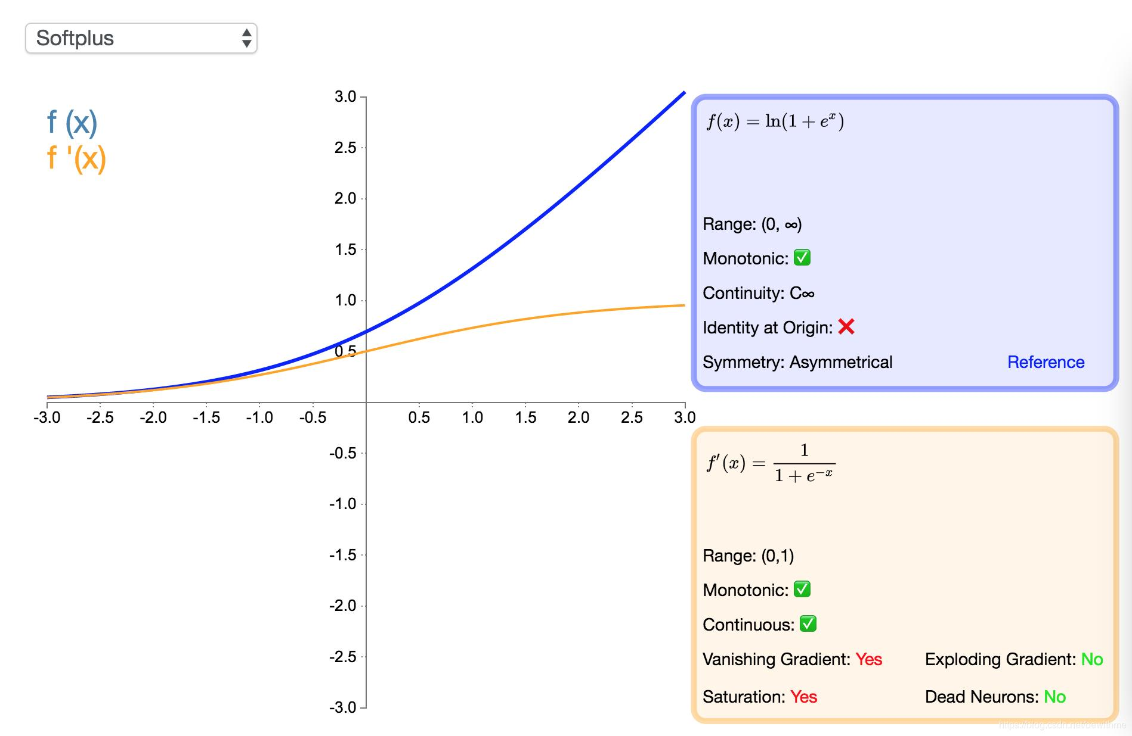
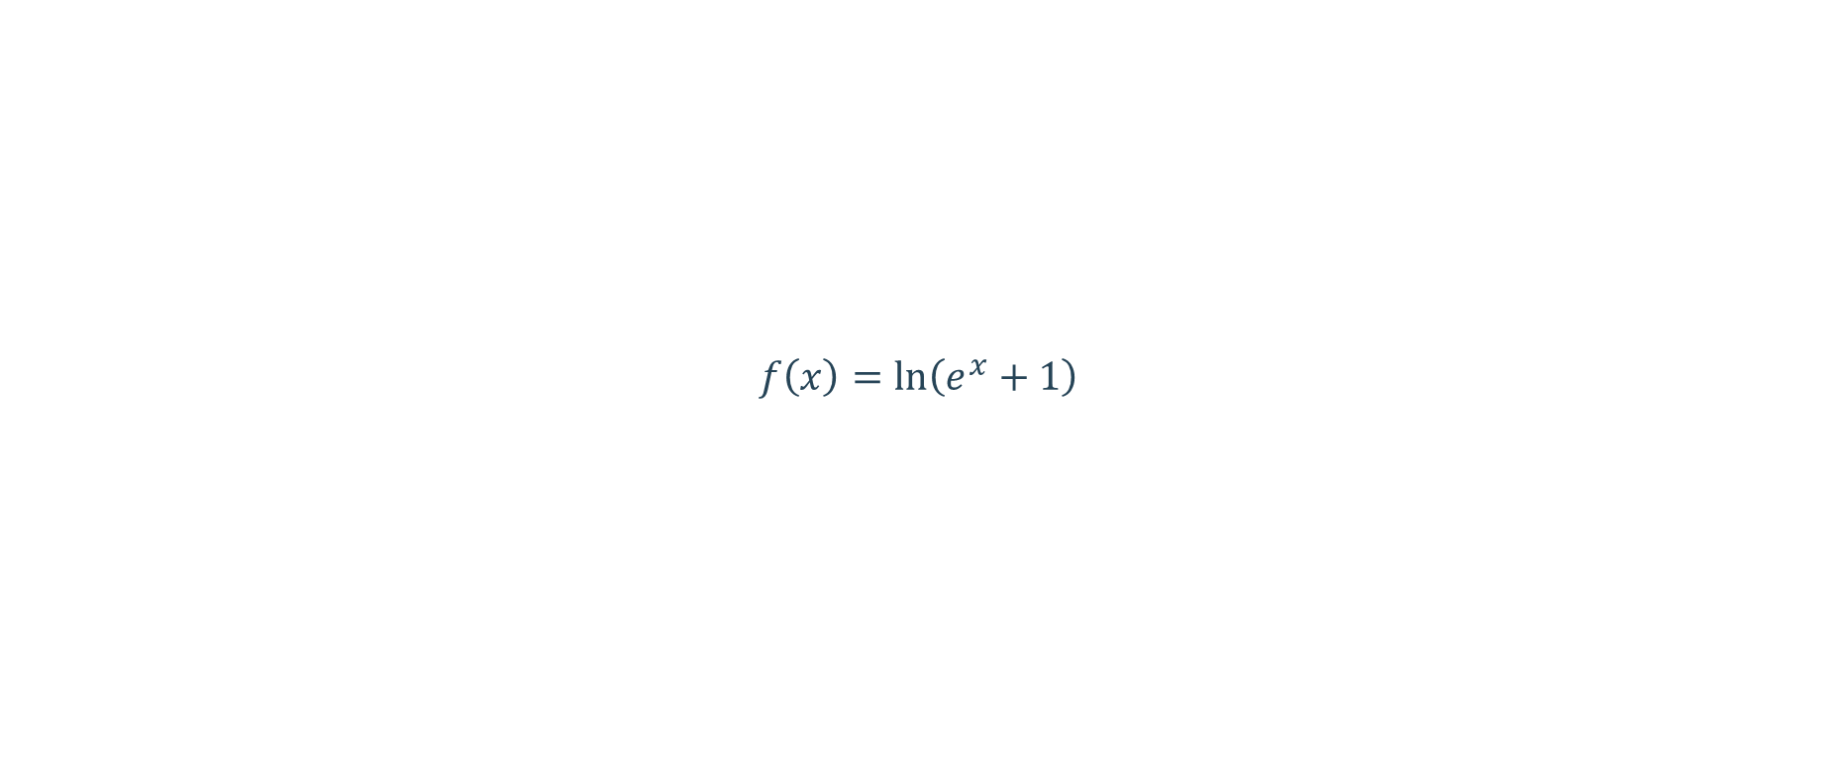
Softplus
$$f\left(x\right)=\ln\left(e^{x}+1\right)$$
Notes:
Compared with ReLU, this function has more complex computation. However, it has a continuous derivative and defines a smooth curved surface.

Slide 32
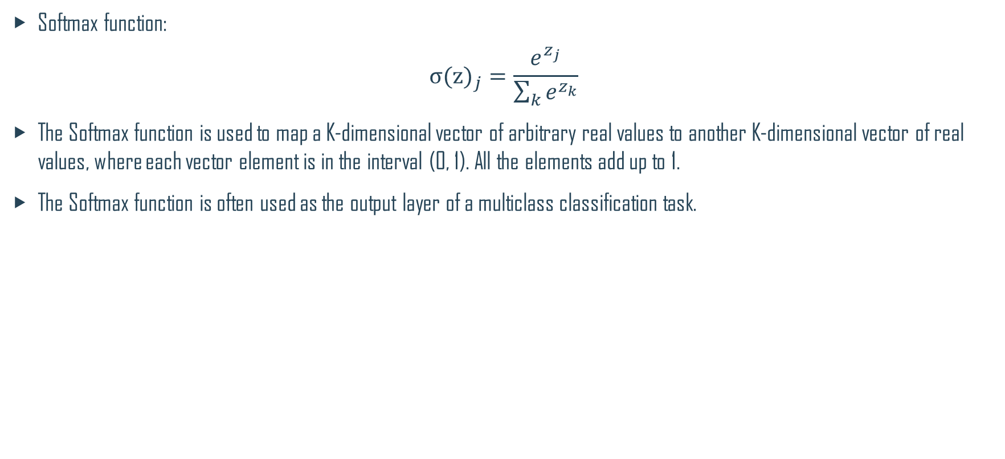
Softmax
Softmax function:
$${σ(z)}_{j}=\frac{e^{z_{j}}}{\sum_{k}{e^{z_{k}}}}$$
The Softmax function is used to map a K-dimensional vector of arbitrary real values to another K-dimensional vector of real values, where each vector element is in the interval (0, 1). All the elements add up to 1.
The Softmax function is often used as the output layer of a multiclass classification task.

Slide 33
Deep Learning Summary
Training Rules
Activation Function
Normalizer
Optimizer
Types of Neural Networks
Common Problems

Slide 34
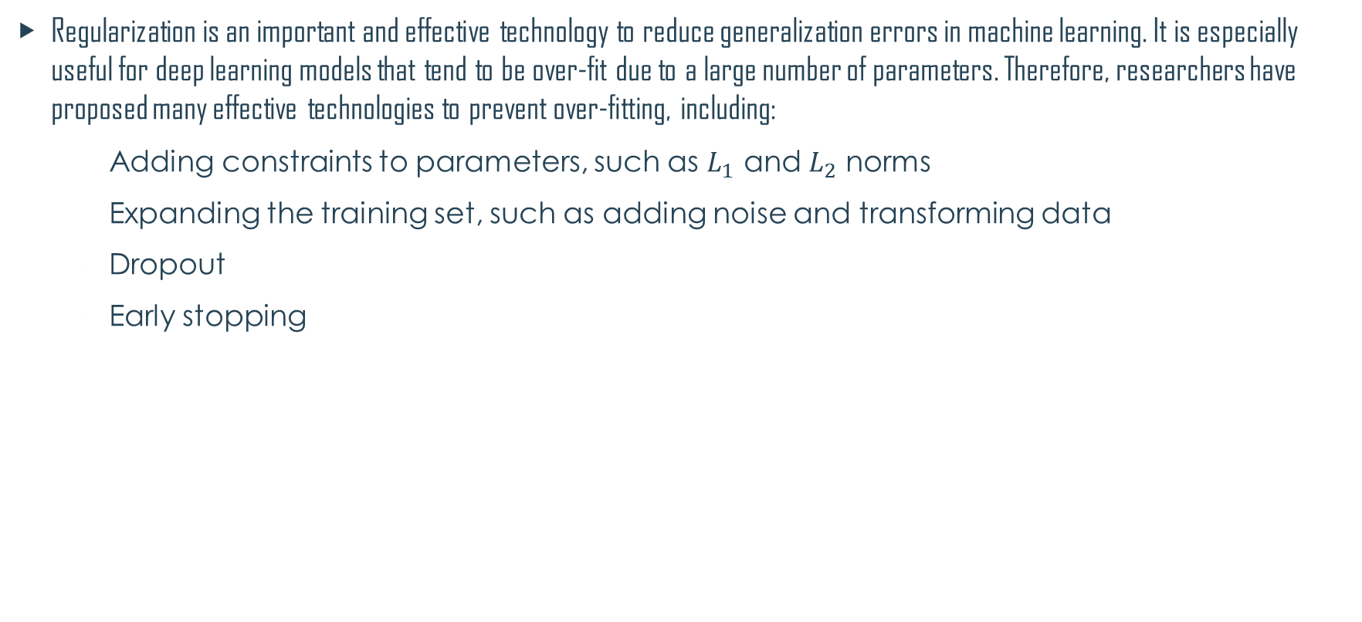
Normalizer
Regularization is an important and effective technology to reduce generalization errors in machine learning. It is especially useful for deep learning models that tend to be over-fit due to a large number of parameters. Therefore, researchers have proposed many effective technologies to prevent over-fitting, including:
Adding constraints to parameters, such as $L_{1}$ and $L_{2}$ norms
Expanding the training set, such as adding noise and transforming data
Dropout
Early stopping

Slide 35
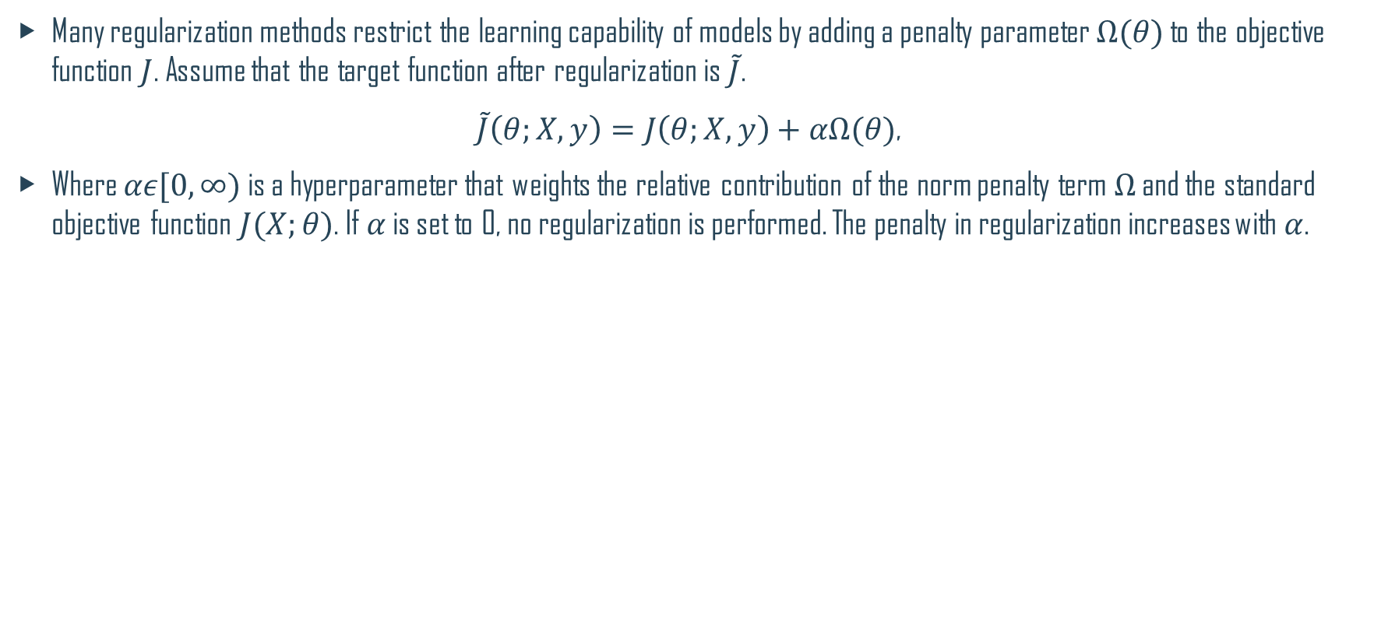
Penalty Parameters
Many regularization methods restrict the learning capability of models by adding a penalty parameter $Ω(θ)$ to the objective function $J$. Assume that the target function after regularization is $\tilde{J}$.
$\tilde{J}\left(θ;X,y\right)=J\left(θ;X,y\right)+αΩ(θ)$,
Where $αε[0,∞)$ is a hyperparameter that weights the relative contribution of the norm penalty term $Ω$ and the standard objective function $J(X;θ)$. If $α$ is set to 0, no regularization is performed. The penalty in regularization increases with $α$.
Notes:
Generally, in deep learning, we add constraints only to affine parameter $w$ but not to biases. The main reason is that biases usually require less data for more accurate fitting. Adding constraints often leads to underfitting.

Slide 36
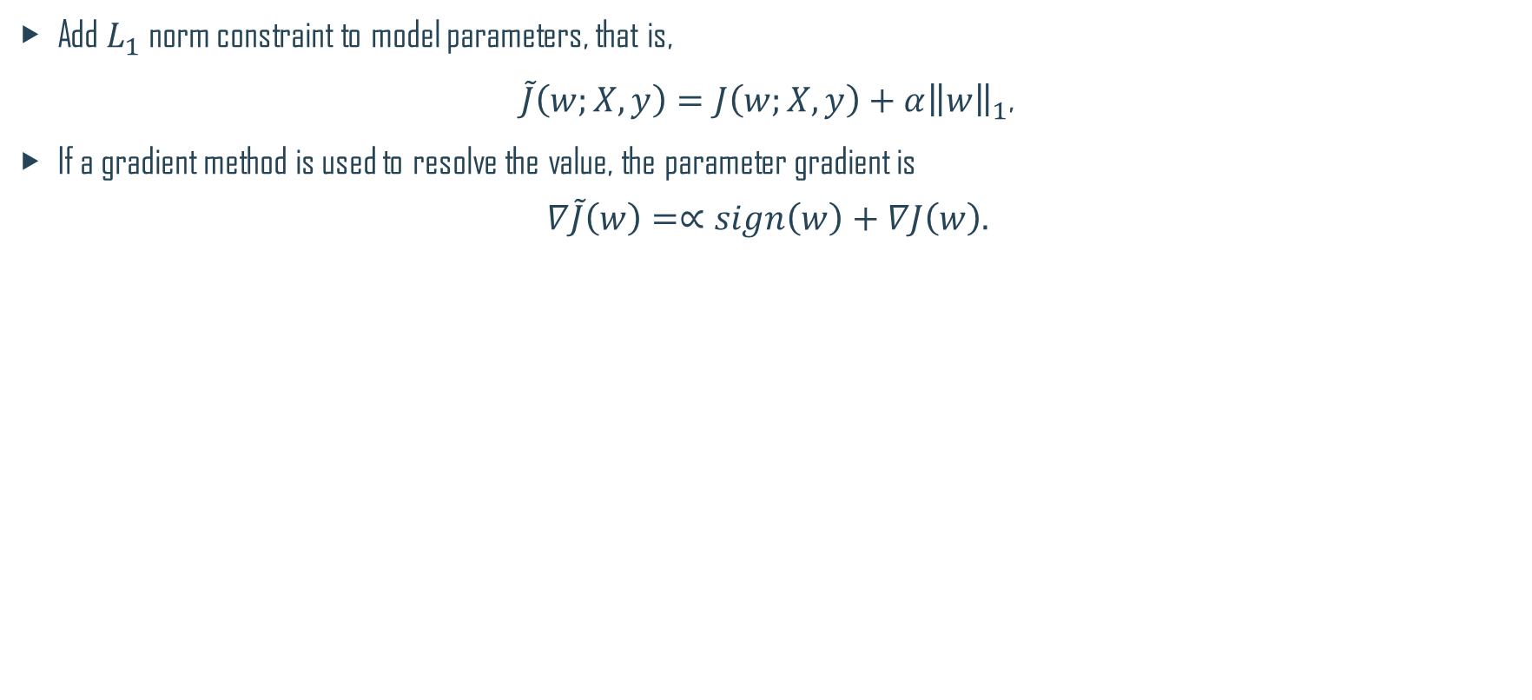
$L_{1}$ Regularization
Add $L_{1}$ norm constraint to model parameters, that is,
$\tilde{J}\left(w;X,y\right)=J\left(w;X,y\right)+α{\left\|w\right\|}_{1}$,
If a gradient method is used to resolve the value, the parameter gradient is
$$∇\tilde{J}\left(w\right)=∝sign\left(w\right)+∇J\left(w\right).$$
Notes:
In special cases, for secondary optimization and assuming that the corresponding Hessian matrix is a diagonal matrix, the parameter recursive formula is $w_{i}=sign\left(w_{i}^{∗}\right)max(\left|w_{i}^{∗}\right|−\frac{α}{λ_{i}},0)$. According to this formula, the parameter value is reduced to 0 if $\left|w_{i}^{∗}\right|<\frac{α}{λ_{i}}$. This implementation is different from $L_{2}$ regularization. Compared with $L_{2}$ regularization, $L_{2}$ regularization does not directly reduce the parameter value to 0 but a value close to 0.

Slide 37
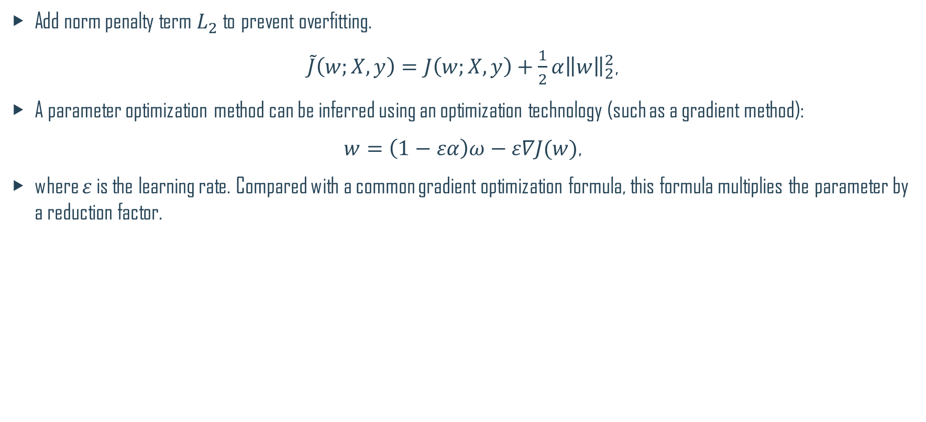
$L_{2}$ Regularization
Add norm penalty term $L_{2}$ to prevent overfitting.
$\tilde{J}\left(w;X,y\right)=J\left(w;X,y\right)+\frac{1}{2}α{\left\|w\right\|}_{2}^{2}$,
A parameter optimization method can be inferred using an optimization technology (such as a gradient method):
$w=\left(1−εα\right)ω−ε∇J(w)$,
where $ε$ is the learning rate. Compared with a common gradient optimization formula, this formula multiplies the parameter by a reduction factor.
Notes:
If $J$ is a secondary optimization formula, the model parameter may be further represented as ${\tilde{w}}_{i}=\frac{λ_{i}}{λ_{i}+α}w_{i}$, that is, adding a control factor to the original parameter, where λ is an eigenvalue of the parameter Hessian matrix. Therefore:
When $λ_{i}≫∝$, the penalty factor has a small effect.
When $λ_{i}≪∝$, the corresponding parameter value is reduced to 0.

Slide 38
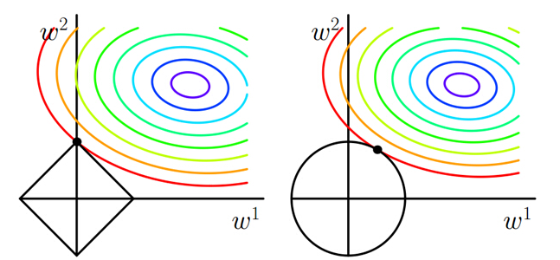
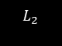
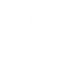
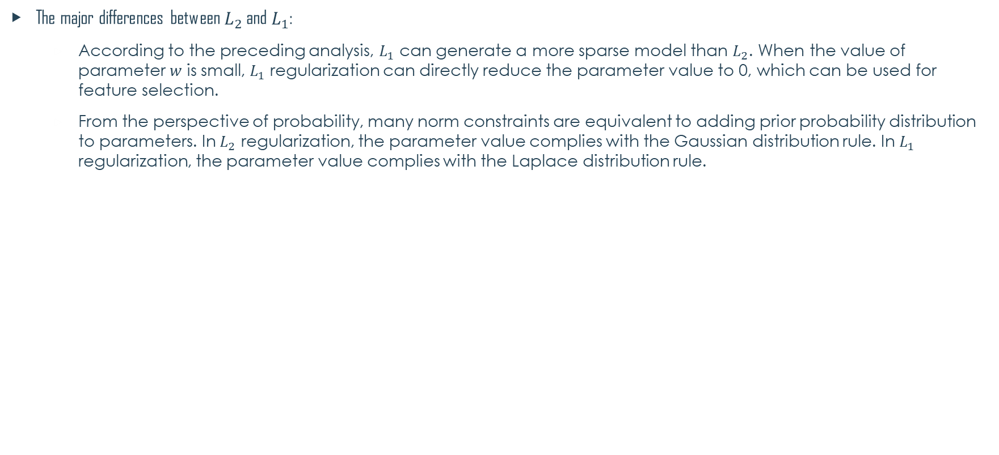
$L_{1}$ v.s. $L_{2}$
The major differences between $L_{2}$ and $L_{1}$:
According to the preceding analysis, $L_{1}$ can generate a more sparse model than $L_{2}$. When the value of parameter $w$ is small, $L_{1}$ regularization can directly reduce the parameter value to 0, which can be used for feature selection.
From the perspective of probability, many norm constraints are equivalent to adding prior probability distribution to parameters. In $L_{2}$ regularization, the parameter value complies with the Gaussian distribution rule. In $L_{1}$ regularization, the parameter value complies with the Laplace distribution rule.
$$L_{1}$$
$$L_{2}$$

Slide 39
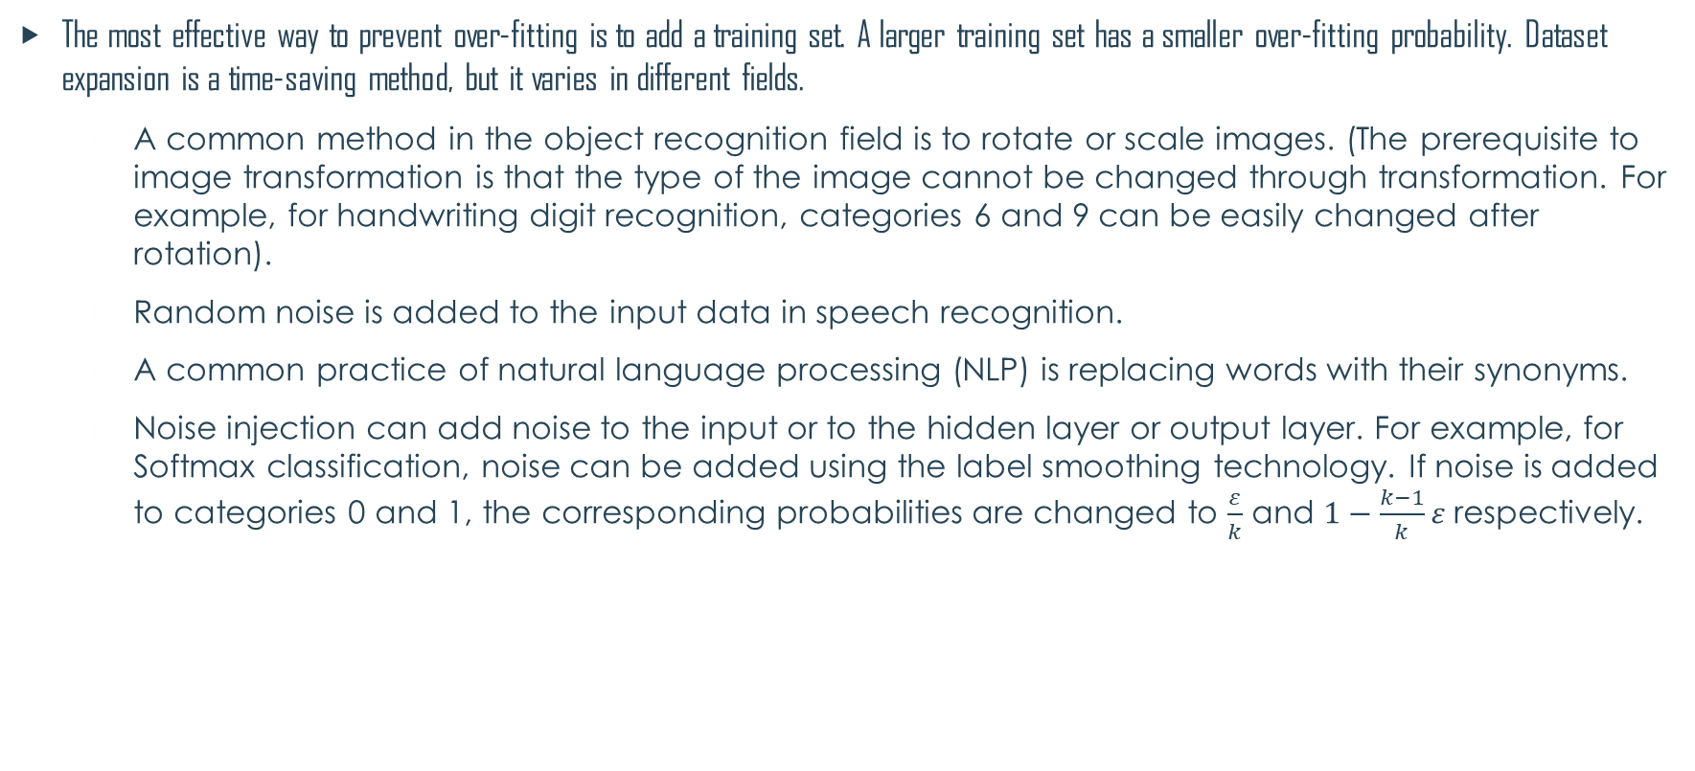
Dataset Expansion
The most effective way to prevent over-fitting is to add a training set. A larger training set has a smaller over-fitting probability. Dataset expansion is a time-saving method, but it varies in different fields.
A common method in the object recognition field is to rotate or scale images. (The prerequisite to image transformation is that the type of the image cannot be changed through transformation. For example, for handwriting digit recognition, categories 6 and 9 can be easily changed after rotation).
Random noise is added to the input data in speech recognition.
A common practice of natural language processing (NLP) is replacing words with their synonyms.
Noise injection can add noise to the input or to the hidden layer or output layer. For example, for Softmax classification, noise can be added using the label smoothing technology. If noise is added to categories 0 and 1, the corresponding probabilities are changed to $\frac{ε}{k}$ and $1−\frac{k−1}{k}ε$ respectively.

Slide 40
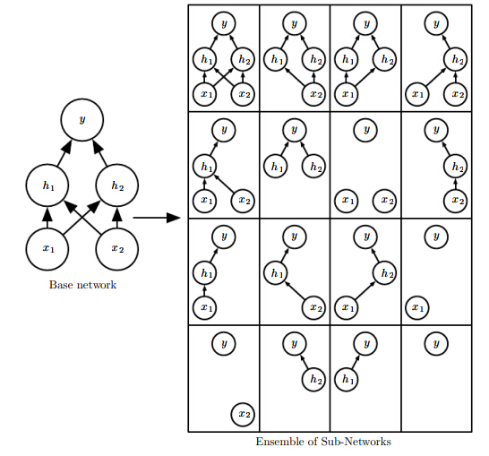

Dropout
Dropout is a common and simple regularization method, which has been widely used since 2014. Simply put, Dropout randomly discards some inputs during the training process. In this case, the parameters corresponding to the discarded inputs are not updated. As an integration method, Dropout combines all sub-network results and obtains sub-networks by randomly dropping inputs. See the figures below:
Notes:
The sampling probability of each entry is 0.8 for the input and 0.5 for the hidden layers.
Advantages:
Compared with weight decay and norm constraints, this strategy is more effective.
It is computationally cheap and simple and can be used in other non-deep-learning models.
However, it is less effective when the training data is insufficient.
Stochasticity is not necessary or sufficient to achieve the regularizing effect of dropout. Invariant shielding parameters can be constructed to obtain good solutions.
In addition to the preceding methods, we can also use semi-supervised learning, multi-task learning, early stopping, parameter sharing, ensemble methods, and adversarial training.

Slide 41

Early Stopping
A test on data of the validation set can be inserted during the training. When the data loss of the verification set increases, perform early stopping.
Early stopping

Slide 42
Deep Learning Summary
Training Rules
Activation Function
Normalizer
Optimizer
Types of Neural Networks
Common Problems

Slide 43
Optimizer
There are various optimized versions of gradient descent algorithms. In object-oriented language implementation, different gradient descent algorithms are often encapsulated into objects called optimizers.
Purposes of the algorithm optimization include but are not limited to:
Accelerating algorithm convergence.
Preventing or jumping out of local extreme values.
Simplifying manual parameter setting, especially the learning rate (LR).
Common optimizers: common GD optimizer, momentum optimizer, Nesterov, AdaGrad, AdaDelta, RMSProp, Adam, AdaMax, and Nadam.

Slide 44



Momentum Optimizer
A most basic improvement is to add momentum terms for $∆w_{ji}$. Assume that the weight correction of the $n$-th iteration is $∆w_{ji}(n)$. The weight correction rule is:
$∆w_{ji}^{l}\left(n\right)=−ηδ_{i}^{l+1}x_{j}^{l}(n)+α∆w_{ji}^{l}\left(n−1\right)$
where $α$ is a constant (0 ≤ $α$ < 1) called Momentum Coefficient and $α∆w_{ji}\left(n−1\right)$ is a momentum term.
Imagine a small ball rolls down from a random point on the error surface. The introduction of the momentum term is equivalent to giving the small ball inertia.
$$−ηδ_{i}^{l+1}x_{j}^{l}(n)$$

Slide 45


Advantages and Disadvantages of Momentum Optimizer
Advantages:
Enhances the stability of the gradient correction direction and reduces mutations.
In areas where the gradient direction is stable, the ball rolls faster and faster (there is a speed upper limit because $α<1$), which helps the ball quickly overshoot the flat area and accelerates convergence.
A small ball with inertia is more likely to roll over some narrow local extrema.
Disadvantages:
The learning rate $η$ and momentum $α$ need to be manually set, which often requires more experiments to determine the appropriate value.

Slide 46

AdaGrad Optimizer (1)
The common feature of the random gradient descent algorithm (SGD), small-batch gradient descent algorithm (MBGD), and momentum optimizer is that each parameter is updated with the same LR.
According to the approach of AdaGrad, different learning rates need to be set for different parameters.
$g_{t}$indicates the t-th gradient, $r$ is a gradient accumulation variable, and the initial value of $r$ is 0, which increases continuously.$η$ indicates the global LR, which needs to be set manually. $ε$ is a small constant, and is set to about 10⁻⁷ for numerical stability.
Gradient calculation
Square gradient accumulation
Computing update
Application update

Slide 47

AdaGrad Optimizer (2)
The AdaGrad optimization algorithm shows that the $r$ continues increasing while the overall learning rate keeps decreasing as the algorithm iterates. This is because we hope LR to decrease as the number of updates increases. In the initial learning phase, we are far away from the optimal solution to the loss function. As the number of updates increases, we are closer to the optimal solution, and therefore LR can decrease.
Pros:
The learning rate is automatically updated. As the number of updates increases, the learning rate decreases.
Cons:
The denominator keeps accumulating so that the learning rate will eventually become very small, and the algorithm will become ineffective.

Slide 48

RMSProp Optimizer
The RMSProp optimizer is an improved AdaGrad optimizer. It introduces an attenuation coefficient to ensure a certain attenuation ratio for $r$ in each round.
The RMSProp optimizer solves the problem that the AdaGrad optimizer ends the optimization process too early. It is suitable for non-stable target handling and has good effects on the RNN.
$g_{t}$indicates the t-th gradient, $r$ is a gradient accumulation variable, and the initial value of $r$ is 0, which may not increase and needs to be adjusted using a parameter. $β \text{is} \text{the} \text{attenuation} \text{factor}\text{,} η$indicates the global LR, which needs to be set manually. $ε$ is a small constant, and is set to about 10⁻⁷ for numerical stability.
Gradient calculation
Square gradient accumulation
Computing update
Application update
Notes:
m indicates the number of samples used.

Slide 49

Adam Optimizer (1)
Adaptive Moment Estimation (Adam): Developed based on AdaGrad and AdaDelta, Adam maintains two additional variables $m_{t}$ and $v_{t}$ for each variable to be trained:
$$m_{t}=β_{1}m_{t−1}+(1−β_{1})g_{t}$$
$$v_{t}=β_{2}v_{t−1}+(1−β_{2})g_{t}^{2}$$
Where $t$ represents the $t$-th iteration and $g_{t}$ is the calculated gradient. $m_{t}$ and $v_{t}$ are moving averages of the gradient and square gradient. From the statistical perspective, $m_{t}$ and $v_{t}$ are estimates of the first moment (the average value) and the second moment (the uncentered variance) of the gradients respectively, which also explains why the method is so named.
Notes:
Adam attempts to calculate adaptive learning rates for each parameter. This is very useful in complex network structures because different parts of the network have different sensitivity to weight adjustment. A very sensitive part usually requires a smaller learning rate. It is difficult or complex to manually identify the sensitive part and set a learning rate. It may be the best optimizer at present.

Slide 50

Adam Optimizer (2)
If $m_{t}$ and $v_{t}$ are initialized using the zero vector, $m_{t}$ and $v_{t}$ are close to 0 during the initial iterations, especially when $β_{1}$ and $β_{2}$ are close to 1. To solve this problem, we use ${\hat{m}}_{t}$ and ${\hat{v}}_{t}$:
$${\hat{m}}_{t}=\frac{m_{t}}{1−β_{1}^{t}}$$
$${\hat{v}}_{t}=\frac{v_{t}}{1−β_{2}^{t}}$$
The weight update rule of Adam is as follows:
$$w_{t+1}=w_{t}−\frac{η}{\sqrt{{\hat{v}}_{t}}+ε}{\hat{m}}_{t}$$
Although the rule involves manual setting of $η$, $β_{1}$, and $β_{2}$, the setting is much simpler. According to experiments, the default settings are $β_{1}=0.9$, $β_{2}=0.999$, $ε={10}^{−8}$, and $η$ = 0.001. In practice, Adam will converge quickly. When convergence saturation is reached, xx can be reduced. After several times of reduction, a satisfying local extremum will be obtained. Other parameters do not need to be adjusted.

Slide 51


Optimizer Performance Comparison
Comparison of optimization algorithms in contour maps of loss functions
Comparison of optimization algorithms at the saddle point

Slide 52
Deep Learning Summary
Training Rules
Activation Function
Normalizer
Optimizer
Types of Neural Networks
Common Problems

Slide 53
Convolutional Neural Network
A convolutional neural network (CNN) is a feedforward neural network. Its artificial neurons may respond to surrounding units within the coverage range. CNN excels at image processing. It includes a convolutional layer, a pooling layer, and a fully connected layer.
In the 1960s, Hubel and Wiesel studied cats' cortex neurons used for local sensitivity and direction selection and found that their unique network structure could simplify feedback neural networks. They then proposed the CNN.
Now, CNN has become one of the research hotspots in many scientific fields, especially in the pattern classification field. The network is widely used because it can avoid complex pre-processing of images and directly input original images.
Notes:
A filter matrix is a set of fixed weight and can be seen as a constant filter (kernel). The convolution (adding each element, weighted by the kernel) is performed between an image (data from different data windows) and a kernel. This type of network is called CNN.
Local receptive field: It is generally considered that human perception of the outside world is from local to global. Spatial correlations among local pixels of an image are closer than those among pixels that are far away. Therefore, each neuron does not need to know the global image. It only needs to know the local image and then the local information is combined at a higher level to generate global information. The idea of local network connection is also inspired by the biological visual system structure. The neurons in the visual cortex receive local information (respond to stimuli of certain regions).
Parameter sharing: One or more filters can be used to scan the input images. The parameters of the filter are weights. At the layers scanned by the same filter, each filter uses the same parameters to perform weighted calculation. Weight sharing means that the parameter values of each filter does not change when the filter scans the entire image. For example, if we have three feature filters and each filter scans the entire image. During the scanning process, the parameter values of the filters do not change. In other words, all elements of the image share the same weights.

Slide 54
Main Concepts of CNN
Local receptive field: It is generally considered that human perception of the outside world is from local to global. Spatial correlations among local pixels of an image are closer than those among distant pixels. Therefore, each neuron does not need to know the global image. It only needs to know the local image. The local information is combined at a higher level to generate global information.
Parameter sharing: One or more filters/kernels may be used to scan input images. Parameters carried by the filters are weights. In a layer scanned by filters, each filter uses the same parameters during weighted computation. Weight sharing means that when each filter scans an entire image, parameters of the filter are fixed.
Notes:
Local receptive field: The idea of local network connection is also inspired by the biological visual system structure. The neurons in the visual cortex receive local information (respond to stimuli of certain regions).
Parameter sharing: For example, if we have three feature convolution kernels and each kernel scans the entire image, the parameter values of the convolution kernels do not change during the scanning process. In other words, all elements of the image share the same weights. This means that the features learned from a part of the image can also be applied to other parts of the image or other images, which is called position invariance.

Slide 55


Architecture of Convolutional Neural Network
Input image
Three-feature image
Three-feature image
Five-feature image
Five-feature image
Output layer
Convolutional layer
Pooling layer
Convolutional layer
Pooling layer
Fully connected layer
Bird
P_{bird}
Sunset
P_{sunset}
Dog
P_{dog}
Cat
P_{cat}
Vectorization
Convolution + nonlinearity
Max pooling
Convolution layers + pooling layers
Multi-category
Fully connected layer
Notes:
Input layer: inputs data.
Convolutional layer: composed of several convolutional units. The parameters of each convolutional unit are obtained by optimizing the backpropagation algorithm. The purpose of convolution calculation is to extract different input features. The first convolutional layer may extract only some low-level features such as edges, lines, and angles. A multi-layer network can extract more complex features based on the low-level features.
Rectified linear units layer (ReLU layer): uses ReLU f(x) = max(0, x) as the activation function.
Pooling layer: partitions features obtained from the convolutional layer into some areas and outputs the maximum or minimum value, generating new features with a smaller spatial size.
Fully connected layer: integrates all local features into global features to calculate the final scores for each type.
Output layer: outputs the final result.

Slide 56

Single-Filter Calculation (1)
Description of convolution calculation

Slide 57

Single-Filter Calculation (2)
Demonstration of the convolution calculation
Han Bingtao, 2017, Convolutional Neural Network

Slide 58

Convolutional Layer
The basic architecture of a CNN is multi-channel convolution consisting of multiple single convolutions. The output of the previous layer (or the original image of the first layer) is used as the input of the current layer. It is then convolved with the filter in the layer and serves as the output of this layer. The convolution kernel of each layer is the weight to be learned. Similar to FCN, after the convolution is complete, the result should be biased and activated through activation functions before being input to the next layer.
Input tensor
Output tensor
Activate
Output
Convolutional kernel
Bias

Slide 59

Pooling Layer
Pooling combines nearby units to reduce the size of the input on the next layer, reducing dimensions. Common pooling includes max pooling and average pooling. When max pooling is used, the maximum value in a small square area is selected as the representative of this area, while the mean value is selected as the representative when average pooling is used. The side of this small area is the pool window size. The following figure shows the max pooling operation whose pooling window size is 2.
Sliding direction
Notes:
The actual classification networks are feedforward networks that are formed by interconnected convolutional and pooling layers. The pooling layer has the following functions:
Invariance: Max pooling ensures invariance within a certain range, because the maximum value of a region is the last output value regardless of where the value is.
Reducing the input size for the next layer: Pooling effectively reduces the size of the input data for the next layer, the number of parameters, and computation workload.
Obtaining fixed-length data: By properly setting the pooling window size and stride, we can obtain fixed-length outputs from variable-length inputs.
Increasing the scale: The features of the previous layer can be extracted from a larger scale.
Preventing overfitting: Pooling simplifies the network and reduces the fitting precision. Therefore, it can prevent overfitting (pay attention to the possible underfitting).

Slide 60

Fully Connected Layer
The fully connected layer is essentially a classifier. The features extracted on the convolutional layer and pooling layer are straightened and placed at the fully connected layer to output and classify results.
Generally, the Softmax function is used as the activation function of the final fully connected output layer to combine all local features into global features and calculate the score of each type.
$${σ(z)}_{j}=\frac{e^{z_{j}}}{\sum_{k}{e^{z_{k}}}}$$

Slide 61
Recurrent Neural Network
The recurrent neural network (RNN) is a neural network that captures dynamic information in sequential data through periodical connections of hidden layer nodes. It can classify sequential data.
Unlike other forward neural networks, the RNN can keep a context state and even store, learn, and express related information in context windows of any length. Different from traditional neural networks, it is not limited to the space boundary, but also supports time sequences. In other words, there is a side between the hidden layer of the current moment and the hidden layer of the next moment.
The RNN is widely used in scenarios related to sequences, such as videos consisting of image frames, audio consisting of clips, and sentences consisting of words.

Slide 62


Recurrent Neural Network Architecture (1)
$X_{t}$ is the input of the input sequence at time t.
$S_{t}$ is the memory unit of the sequence at time t and caches previous information.
$S_{t}=tanh\left(UX_{t}+WS_{t−1}\right)$.
$O_{t}$ is the output of the hidden layer of the sequence at time t.
$O_{t}=tanh\left({VS}_{t}\right)$
$O_{t}$ after through multiple hidden layers, it can get the final output of the sequence at time t.

Slide 63

Recurrent Neural Network Architecture (2)
LeCun, Bengio, and G. Hinton, 2015, A Recurrent Neural Network and the
Unfolding in Time of the Computation Involved in Its Forward Computation

Slide 64

Types of Recurrent Neural Networks
Andrej Karpathy, 2015, The Unreasonable Effectiveness of Recurrent Neural Networks

Slide 65

Backpropagation Through Time (BPTT)
BPTT:
Traditional backpropagation is the extension on the time sequence.
There are two sources of errors in the sequence at time of memory unit: first is from the hidden layer output error at t time sequence; the second is the error from the memory cell at the next time sequence t + 1.
The longer the time sequence, the more likely the loss of the last time sequence to the gradient of w in the first time sequence causes the vanishing gradient or exploding gradient problem.
The total gradient of weight w is the accumulation of the gradient of the weight at all time sequence.
Three steps of BPTT:
Computing the output value of each neuron through forward propagation.
Computing the error value of each neuron through backpropagation $δ_{j}$.
Computing the gradient of each weight.
Updating weights using the SGD algorithm.
Notes:
$z_{t}$ is the value before the memory cell enters the activation function, $δ_{t}=\frac{∂C_{t}}{∂z_{t}}+w^{T}×f_{t}^{′}(z_{t}){×δ}_{t+1}$

Slide 66

Recurrent Neural Network Problem
$S_{t}=σ\left(UX_{t}+WS_{t−1}\right)$ is extended on the time sequence.
$S_{t}=σ\left(UX_{t}+W\left(σ\left(UX_{t−1}+W\left(σ\left(UX_{t−2}+W\left(…\right)\right)\right)\right)\right)\right)$
Despite that the standard RNN structure solves the problem of information memory, the information attenuates during long-term memory.
Information needs to be saved long time in many tasks. For example, a hint at the beginning of a speculative fiction may not be answered until the end.
The RNN may not be able to save information for long due to the limited memory unit capacity.
We expect that memory units can remember key information.

Slide 67


Long Short-term Memory Network
Colah, 2015, Understanding LSTMs Networks
Notes:
Long short-term memory (LSTM) applies to the scenario with a large gap between the relevant information and the point where it is needed. It can connect previous information for long periods of time to the present task.

Slide 68

Gated Recurrent Unit (GRU)
Notes:
As a variant of LSTM, GRU combines the Forget Gate and the Input Gate into a single Update Gate. It mixes the cell state and hidden state and also incorporates other changes. As a popular variant, its final model is simpler than the standard LSTM model. [] indicates concatenation, * indicates element product, and· indicates matrix multiplication.

Slide 69
Generative Adversarial Network (GAN)
Generative Adversarial Network is a framework that trains generator G and discriminator D through the adversarial process. Through the adversarial process, the discriminator can tell whether the sample from the generator is fake or real. GAN adopts a mature BP algorithm.
(1) Generator G: The input is noise z, which complies with manually selected prior probability distribution, such as even distribution and Gaussian distribution. The generator adopts the network structure of the multilayer perceptron (MLP), uses maximum likelihood estimation (MLE) parameters to represent the derivable mapping G(z), and maps the input space to the sample space.
(2) Discriminator D: The input is the real sample x and the fake sample G(z), which are tagged as real and fake respectively. The network of the discriminator can use the MLP carrying parameters. The output is the probability D(G(z)) that determines whether the sample is a real or fake sample.
GAN can be applied to scenarios such as image generation, text generation, speech enhancement, image super-resolution.
Notes:
GAN: Traditional deep generative models require Markov chains or maximum likelihood estimation (MLE), which brings a lot of probability issues difficult to compute.

Slide 70

GAN Architecture
Generator/Discriminator
Notes:
There are two kinds of models in a GAN: generative model and discriminative model. The discriminative model is used to predict the classification based on input variables. The generative model is used to randomly generate observable-data values, typically using some given hidden parameters. Example:
Generative model
Generates a new cat image that does not exist in the dataset with random data given.
Discriminative model
Discriminates the animal (whether it is a cat or not) in a given image.

Slide 71


Generative Model and Discriminative Model
Discriminator network
Determines whether sample data is real
Input: real sample data $x_{real}$ and generated sample data $x=G\left(z\right)$
Output: probability that determines whether the sample is real
Generative network
Generates sample data
Input: Gaussian white noise vector z
Output: sample data vector x
$$x_{real}$$
G
z
x
D
y
x

Slide 72
Training Rules of GAN
Optimization objective:
Value function
In the early training stage, when the outcome of G is very poor, D determines that the generated sample is fake with high confidence, because the sample is obviously different from training data. In this case, log(1-D(G(z))) is saturated (where the gradient is 0, and iteration cannot be performed). Therefore, we choose to train G only by minimizing [-log(D(G(z))].
Notes:
When the value function is used during training, the GAN is called minimax GAN. When [-log(D(G(z))] is used during training, the GAN is called non-saturating GAN.

Slide 73
Deep Learning Summary
Training Rules
Activation Function
Normalizer
Optimizer
Types of Neural Networks
Common Problems

Slide 74
Data Imbalance (1)
Problem description: In the dataset consisting of various task categories, the number of samples varies greatly from one category to another. One or more categories in the predicted categories contain very few samples.
For example, in an image recognition experiment, more than 2,000 categories among a total of 4251 training images contain just one image each. Some of the others have 2-5 images.
Impacts:
Due to the unbalanced number of samples, we cannot get the optimal real-time result because model/algorithm never examines categories with very few samples adequately.
Since few observation objects may not be representative for a class, we may fail to obtain adequate samples for verification and test.

Slide 75
Data Imbalance (2)
Random undersampling
Random oversampling
Copying samples
Synthetic Minority Oversampling Technique
Sampling
Merging samples
Deleting redundant samples in a category
Notes:
Random undersampling: Classes with sufficient observations are randomly deleted to enable significant relative ratio between the two classes. Although this method is easy to use, the deleted data packet may contain important information about the prediction class.
Advantage
It increases the running time. In addition, when the training dataset is large, a storage problem may be resolved by reducing samples.
Disadvantage
It discards potentially valuable information that is important for building a rule classifier.
Samples selected by random undersampling may have a bias. It does not accurately represent the majority. Therefore, the result for an actual test dataset is not accurate.
Random oversampling: For unbalanced classes, we randomly increase the number of observations by copying existing samples. Ideally, we have sufficient samples, but oversampling may lead to overfitting training data.
Advantage
It does not cause information loss.
It outperforms undersampling.
Disadvantage
It increases the likelihood of overfitting because of the replication of minority class event.

Slide 76
Data Imbalance (2)
Random undersampling
Random oversampling
Copying samples
Synthetic Minority Oversampling Technique
Sampling
Merging samples
Deleting redundant samples in a category
Notes:
Synthetic Minority Oversampling Technique (SMOTE) — This technique requires us to obtain observations of the unbalanced classes using a synthetic method, which is similar to the existing k-NN method. The question is what we can do when the number of observations for a class is extremely small. For example, we want to identify a rare species with the picture classification method, but we may have only one picture of this rare species. This technique can be used to avoid overfitting — when we copy minority class instances directly and add them to the main dataset. Take a data subset from a minority class as an instance, and then create similar synthesized instances. These synthesized instances are added to the original dataset. The new dataset is used as a sample to train the classification model.
Advantage
The problem of overfitting can be alleviated by using a synthetic sample generated by random sampling instead of a copy of an instance.
It does not cause loss of valuable information.
Disadvantage
When generating a synthetic instance, SMOTE does not take into account adjacent instances from other classes. This results in an increase in class overlap and causes additional noise.
SMOTE is not very effective for high-dimensional data.

Slide 77


Vanishing Gradient and Exploding Gradient Problem (1)
Vanishing gradient: As network layers increase, the derivative value of backpropagation decreases, which causes a vanishing gradient problem.
Exploding gradient: As network layers increase, the derivative value of backpropagation increases, which causes an exploding gradient problem.
Cause:
Backpropagation can be deduced as follows:
$W\text{here} σ \text{is} \text{sigmoid} \text{function}$.
$$y_{i}=σ_{(z_{i})}=σ\left(w_{i}x_{i}+b_{i}\right)$$
b1
w2
b2
w3
b3
w4
C
$\frac{∂C}{∂b_{1}}=\frac{∂C}{∂y_{4}}$ $\frac{∂y_{4}}{∂z_{4}}\frac{∂z_{4}}{∂x_{4}}$ $\frac{∂x_{4}}{∂z_{3}}$ $\frac{∂z_{3}}{∂x_{3}}$ $\frac{∂x_{3}}{∂z_{2}}$ $\frac{∂z_{2}}{∂x_{2}}$ $\frac{∂x_{2}}{∂z_{1}}$ $\frac{∂z_{1}}{∂b_{1}}$
$=$ $\frac{∂C}{∂y_{4}}σ^{′}\left(z_{4}\right)w_{4}σ^{′}\left(z_{3}\right)w_{3}σ^{′}\left(z_{2}\right)w_{2}σ^{′}\left(z_{1}\right)x$
Notes:
(It is assumed that each layer has only one neuron and for each layer, the activation function is a sigmoid function.)

Slide 78


Vanishing Gradient and Exploding Gradient Problem (2)
The maximum value of $σ^{′}(x)$ is $\frac{1}{4}$:
However, the network weight $\left|w\right|$ is usually smaller than 1. Therefore, $\left|σ^{′}\left(z\right)w\right|≤\frac{1}{4}$. According to the chain rule, as layers increase, the derivation result $\frac{∂C}{∂b_{1}}$ decreases, resulting in the vanishing gradient problem.
When the network weight $\left|w\right|$ is large, resulting in $\left|σ^{′}\left(z\right)w\right|>1$, the exploding gradient problem occurs.
Solution: For example, gradient clipping is used to alleviate the exploding gradient problem, ReLU activation function and LSTM are used to alleviate the vanishing gradient problem.
Notes:
This problem occurs when the value of w is large. However, this problem seldom occurs when the sigmoid activation function is used because $σ^{′}\left(z\right)$ is a
Gradient clipping is proposed for the exploding gradient problem. A gradient clipping threshold is set. When being updated, if the gradient exceeds the threshold, the gradient is forcibly limited within the range. This prevents the exploding gradient problem.
Another approach for resolving the exploding gradient problem is weight regularization, among which l1 regularization and l2 regularization are commonly used. APIs in each deep learning framework may use regularization. For example, in TensorFlow, if regularization parameters have been set during network setup, you can directly calculate the regularization loss by calling the following code.
ReLU: Its idea is simple. If the derivative of the activation function is 1, the vanishing gradient or exploding gradient problem will not occur. That's why the ReLU is developed.
For LSTM, the vanishing gradient problem does not easily occur thanks to the complex gates inside the LSTM. As shown in the following figure, LSTM can "remember" the "residual memory" of the previous training based on the internal gates when it is being updated. Therefore, it is often used in generative text. Currently, there is also CNN-based LSTM. Try it if you are interested.

Slide 79
Overfitting
Problem description: The model performs well in the training set, but badly in the test set.
Root cause: There are too many feature dimensions, model assumptions, and parameters, too much noise, but very few training data. As a result, the fitting function perfectly predicts the training set, while the prediction result of the test set of new data is poor. Training data is over-fitted without considering generalization capabilities.
Solution: For example, data augmentation, regularization, early stopping, and dropout
Notes:
Overfitting causes: insufficient data and complex model
More data: Obtain more data from the data source to achieve data augmentation. Proper model: Reduce the number of network layers and neurons can limit the fitting capability of the network. Dropout; Regularization: The weight increase is restricted during training.
Limit the training time. Pass the evaluation test.
Increase the noise: Input + Weight (Gaussian initialization)
Data data cleansing/pruning: Rectify or delete incorrect labels.
Multiple models: Bagging uses diverse models to fit training sets of different parts. Boosting uses only simple neural networks.
L1 and L2 regularization: Penalty terms are introduced to solve the problem of excessive parameters in the model based on the Occam's Razor principle. In deep learning, L1 tends to generate a small number of features, and other features are all 0 to increase network sparsity. L2 selects more features, which are close to 0 to prevent overfitting. The neural network requires neurons at each layer to extract meaningful features as much as possible. Therefore, L2 regularization is applied more widely.

Slide 80
Overfitting
Problem description: The model performs well in the training set, but badly in the test set.
Root cause: There are too many feature dimensions, model assumptions, and parameters, too much noise, but very few training data. As a result, the fitting function perfectly predicts the training set, while the prediction result of the test set of new data is poor. Training data is over-fitted without considering generalization capabilities.
Solution: For example, data augmentation, regularization, early stopping, and dropout
Notes:
Dropout: The most common regularization technique in deep learning is dropout, which randomly discards some neurons.
Data augmentation: For example, the original image is flipped, translated, and stretched, so that the training dataset of the model is augmented. Data augmentation is a necessary step of deep learning. It is generally effective to improve the generalization capability of models. However, you only need to double the original data volume through data augmentation. However, the increase by 10 times by 100 times only increases the training time, while the generalization capability of the models will no longer be improved.
Early stopping: A model stops at an approximate time point of training. For example, if no improvement can be achieved by continuous training or several consecutive rounds of training, early stopping is performed. This can avoid the problem that only indicators of the training set are improved while indicators of the test set are degraded.
Batch normalization (BN): A regularization layer that adjusts the weights of neurons to standard normal distribution is added between layers of the convolutional neural network. In this way, training at each layer starts from a similar start point, and the weights are stretched, which is equivalent to feature stretching and to data augmentation at the input layer. Note that the normalization layer does not need to be trained.

Slide 81
Thanks
Any questions?

